Slide 1

Corn futures deliveries: Why? When? So what?
Vitor M. O. Fernandes
Eugene L. Kunda*
Michel A. Robe*
* CFTC Disclaimer

Slide 2

Introduction
“A futures contract is a temporary substitute for an eventual cash transaction. In markets that work, delivery is rarely made and taken; futures contracts are entered into for reasons other than exchange of title.”
Hieronymus – Economics of Futures Trading for Commercial and Personal Profit (1977, pg. 340)
Still, deliveries do happen.
Prior literature focuses on convergence problems and/or on valuing embedded options.
Our work aims to enrich our understanding of agricultural futures by: (i) identifying incentives faced by market participants (ii) and, through them, explaining the occurrence of deliveries.

Slide 3
CBOT Corn Futures Delivery System
For CBOT corn, delivery is made not with the actual grain but with a financial instrument (Delivery or Shipping Certificate) that gives the owner control of the physical commodity (while paying storage fees).
Someone who was long and “stops” a futures contract has the following options:
(1) Hold the Cert for as long as desired, paying storage fees;
(2) Sell the Cert at a negotiated price (in the “parallel” market);
(3) Sell futures and “go for delivery”, re-tendering the Cert to fulfill the contract (either in the current month or in a deferred one).

Slide 4
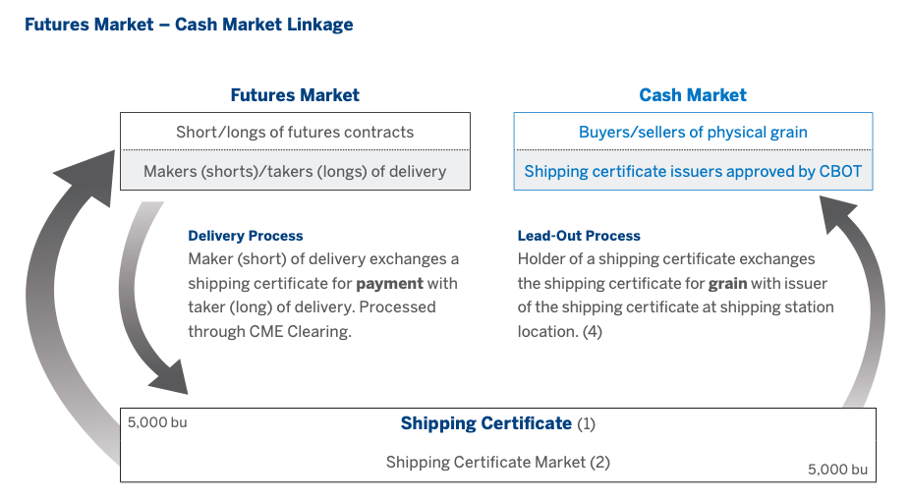
CBOT Corn Futures Delivery System
Source: CME Notes - Corn & Soybeans Delivery Terms (2017, pg. 7)

Slide 5
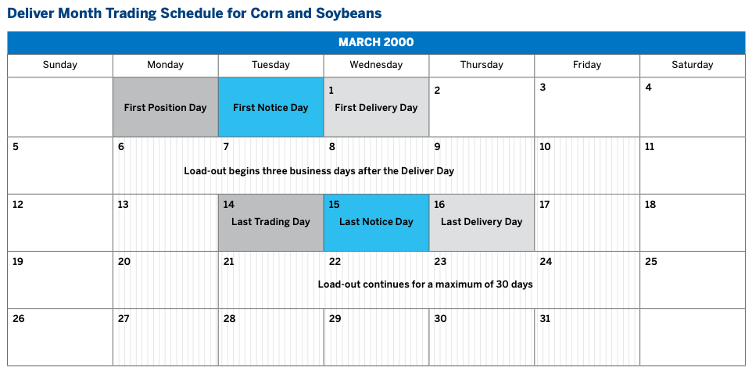
CBOT Corn Futures Delivery System
3-day sequence in delivery period:
Intention day (short) = Position day (long)
Short declares to Exchange (CBOT) its intention of “going for delivery”. Exchange assigns it to the oldest outstanding long. Both positions are liquidated at settlement price.
Notice Day
Exchange sends the long an invoice. Long learns location of physical commodity.
Delivery Day
Seller (former short) and buyer (former long) exchange instrument of delivery (Cert) against payment (cash).

Slide 6
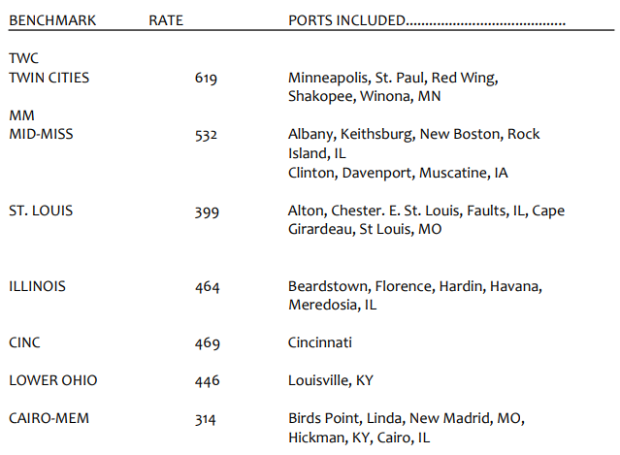
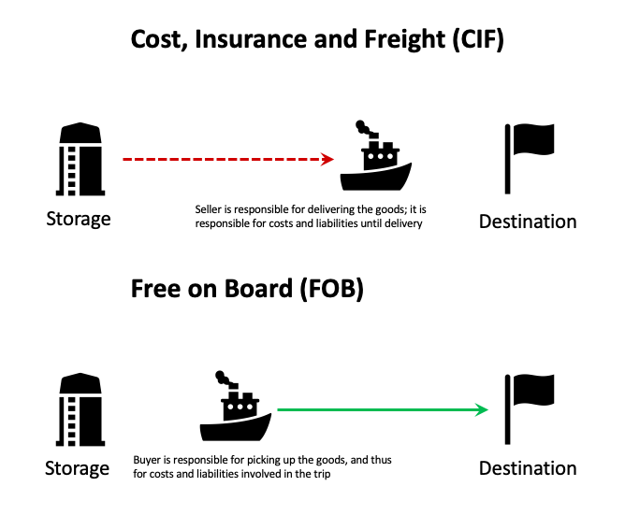
Barge system
Barge prices along the Mississippi river are unregulated and can be seen as a commodity per se (Wetztein et al, 2021);
U.S. Inland Waterway System uses a percent of tariff system to establish barge freight rates. This tariff is no longer officially applicable, but the barge freight industry still uses it as a benchmark to establish rates;
To obtain freight rate in $/ton, multiply the % tariff rate by the 1976 benchmark.
Example: Twin cities rate = 200%; benchmark rate = $6.19; freight is therefore $12.38/ton.
Each city on the river has its own benchmark; northernmost cities have the highest benchmarks.

Slide 7
Delivery Value Equivalent (DVE)
Occurrence of deliveries:
We have talked about the delivery system.
Now we will talk about why deliveries happen.
Delivery period: short has the option of fulfilling contract terms through delivery;
The physical grain owner can choose whether to market his/her grain through the cash or the futures markets;
The Delivery Value Equivalent (DVE) is a framework for comparison between the two.

Slide 8
Delivery Value Equivalent (DVE)
GSC Glossary: “DVE is a basis level sufficient to allow moving into or out of a futures delivery position” (GSC pg. 9)
We define it as the following:
DVE (cif NOLA) = Premiums + Freight + Costs
where:
Premiums = Quality differential + Location differential
Freight = Benchmark Tariff * C Factor * Barge Freight Rate
Costs = Load-out fee + Storage fee + Weights & Grades fee

Slide 9
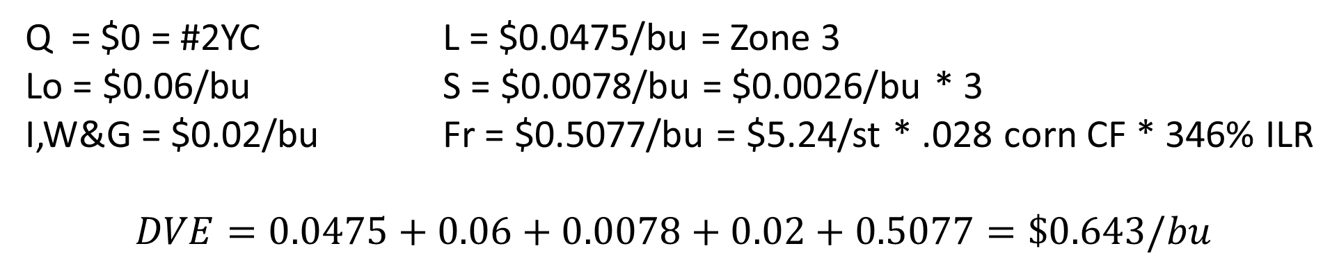
DVE – Numerical Example (as time allows)
Regular firm ABCD has a net short May 2021 hedge position in expiring corn futures and corn at Morris, IL. Using April 27th, 2021 values:
Q = $0 = #2YC L = $0.0475/bu = Zone 3
Lo = $0.06/bu S = $0.0078/bu = $0.0026/bu * 3
I,W&G = $0.02/bu Fr = $0.5077/bu = $5.24/st * .028 corn CF * 346% ILR
$$DVE=0.0475+0.06+0.0078+0.02+0.5077=\$0.643/bu$$
Given CIF NOLA basis for that day = $0.645/bu (K)
DVE = Basis
ABCD is indifferent and will buy May futures and sell CIF NOLA or make delivery.

Slide 10
Testable Hypotheses
#1 Occurrence: The difference between (i) NoLa basis & (ii) DVE has no impact on the occurrence or on the quantity of deliveries (we expect to reject this hypothesis);
#2 Timing: When market is in carry, deliveries tend to happen early; When carry is absent, deliveries tend to happen late (we expect to accept this hypothesis);
#3 Impact: Issuing new Shipping Certificates in the delivery period has no impact on the nearby calendar spread price (we expect to reject this hypothesis);
Impact from the close of the day-trading session to the opening of the overnight-trading session;
Front-month to first-deferred spread.

Slide 11
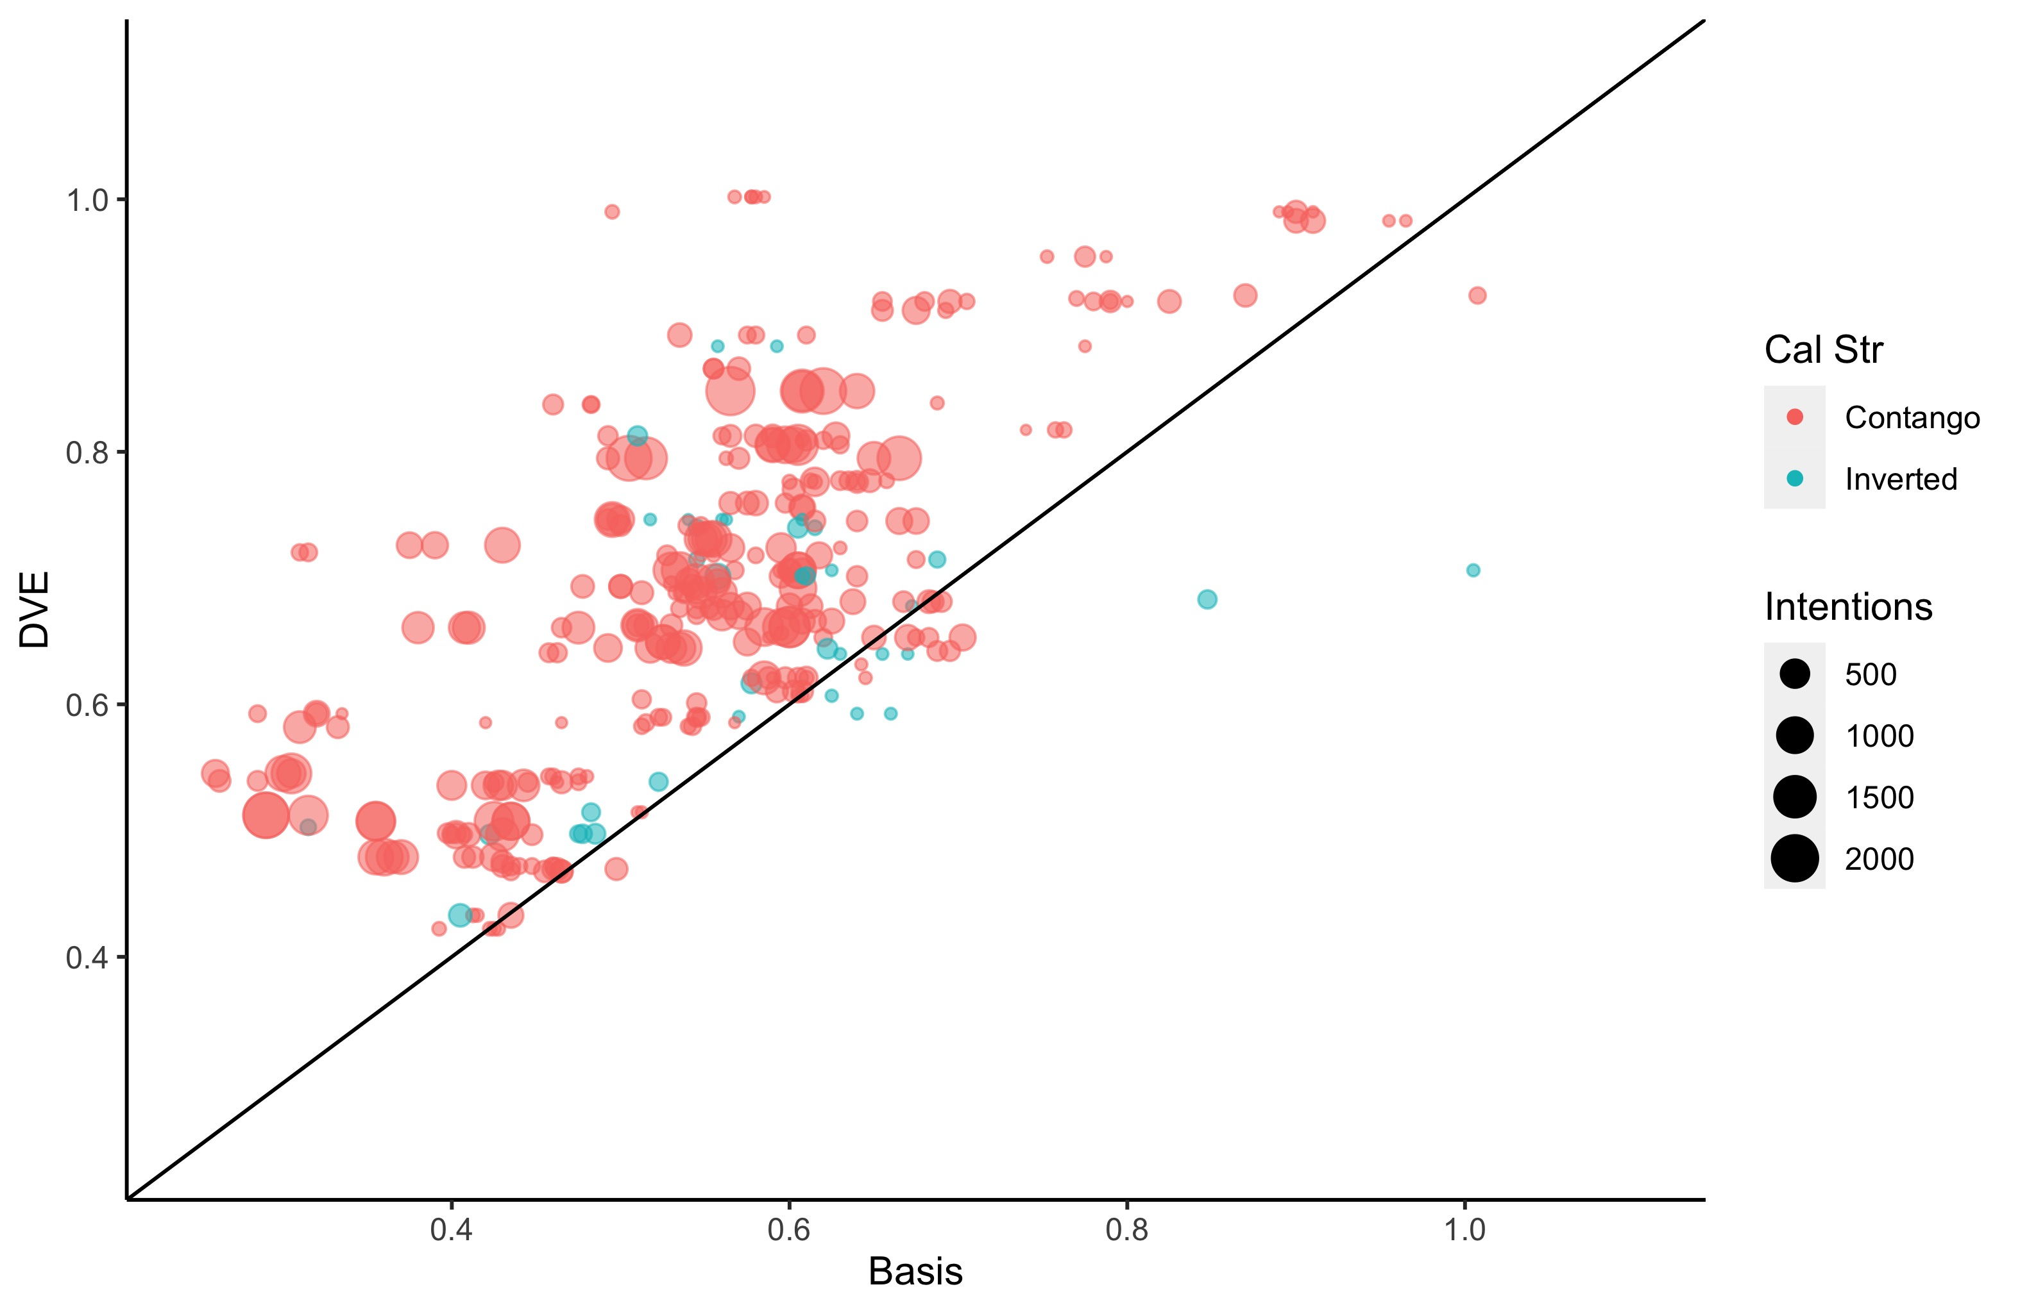
1. Results: Why? – DVE vs. Basis
#Intentions and DVE vs. Basis
Deliveries should happen
when DVE > Basis
Transversal Line: DVE = Basis
344 days with deliveries
318 in days when DVE > Basis; only 26 in days when DVE < Basis
108,318 (97.6%) contracts in days where DVE > Basis; only 2,656 contracts when DVE < Basis (2.4%)
Our intuition was correct

Slide 12
1. Results – DVE vs. Basis (as time allows)
Negative relation, as expected from Hypothesis 1: The closer to 0 the value of (Basis – DVE) is, the smaller the # deliveries should be.
Av. (Basis-DVE) significant (at 10% or less) in all 48 models
5% in 45/48 models
1% or less in 29/48 models;
Comparing models without R²: shared variance between predicted and observed values
Best fit models control for month, calendar slope, and include the first 4 to 11 days of the delivery sequence.

Slide 13
2. Results – When? Timing:
First intentions should happen:
amid contango: at the very beginning of the delivery period;
in backwardation: at the very end.
Findings: our intuition is correct
12,975 of all 14,813 deliveries under contango happen in first 2 days of delivery period;
734 of all 997 deliveries under backwardation happen in last 2 days of delivery period.

Slide 14
2. Results - Timing
1st intentions only
II. Delving into patterns (as time allows):
1st intentions mostly on Last Trading Day (LTD) for backwardation;
Redeliveries
Certificates change hands “like a hot potato”. Intentions shrink in magnitude but remain plentiful until LTD. Certificates get cancelled or are held as arbitrage is no longer viable
Pattern:
with carry, early deliveries initiated by short;
no carry, long forces delivery;
Optionality in action: people sometimes hold on to their positions.
All intentions

Slide 15
3. Results: So What? Deliveries & Spreads
CME updates/publishes DCUR table everyday at 4pm;
Only entities able to issue new Certificates are regular firms;
Once a Certificate is issued, the regular must go to delivery;
New issue = incoming delivery;
Hypothesis 3: An increase in Certs weakens the spread
Intuition: F₁ (= nearby) falls but F₂ (= first deferred) is unaffected
Formal test: The issuance of certificates in the delivery period has no impact on the nearby spread expect to reject

Slide 16
3. Results: Deliveries & Spreads
Puzzling finding: No obvious difference in the spread returns on days when DCUR decrease (LHS) vs. on days when DCUR increase (RHS)
Revision underway: control for “weak hands”

Slide 17
Final Remarks
DVE framework helps understand why corn deliveries take place:
Futures are used as a merchandising tool more often by sellers than by buyers;
DVE – basis difference drives optimality of deliveries.
When deliveries happen: Timing depends on market carry
Deliveries happen (i) early when there is carry and (ii) late when there is no carry.
Surprisingly, on average, we find no impact of deliveries on calendar spread prices (close-to-open returns):
Unconditional result; currently working on conditioning info.

