Slide 1


Real-Time Tracking of Public Announcements in the Limit Order Book
Mehdi Arzandeh, Lakehead University (Email: Mehdi.Arzandeh@lakeheadu.ca)
Julieta Frank, University of Manitoba
Justin Daniels, University of Manitoba
7th J.P. Morgan Center International Commodities Symposium
August 12-13, 2024, Denver, CO.

Slide 2
Introduction
The effect of public news on markets have been studied in the finance literature
The USDA started to publish agricultural commodity reports containing commodity current situation and expectations in the 1970s
Falk and Orazem (1984): government crop forecast reports can generate economic value
Subsequent studies found that prices react significantly to USDA reports e.g., Fortenbery and Summer (1990), Colling and Irwin (1990), Isengildian et al. (2006), Isengildina-Massa et al. (2008)
Agricultural commodity futures markets migrated to electronic trading systems: direct interaction of buyers and sellers.
Trading occurs through the presence of the limit order book (LOB)
Reduced trading latency
Studies with intraday data are needed

Slide 3
Introduction
Few studies are performed on agricultural futures market reaction to new information using intraday data
Perez et al. (2019) and Shang et al. (2018): the adverse selection component of the bid-ask spread (BAS) increases during the first 20 minutes and 30 minutes to an hour, respectively, after the announcements
Adjemian and Irwin (2018): volatility increases and the average size per trade decreases after USDA announcements; new information is incorporated into prices within a few minutes
Kauffman (2013) and Joseph and Garcia (2018): volatility increases after the announcement
Lehecka et al. (2014): price reacts strongly to the announcements; the effect lasts about ten minutes.
Previous studies have used either transaction level prices and volumes or the best bid and ask
Siikanen et al. (2017): order book liquidity in NASDAQ Nordic stocks is significantly affected by public news arrivals – improved liquidity with scheduled news; book imbalances with unscheduled news
Arzandeh and Frank (2019): there is a contribution of over 30% from the LOB, beyond the BAS, to price discovery in major agricultural commodity markets

Slide 4
Introduction
In 2013, the USDA changed the release time of some of the major grain reports from 8:30 am ET to 12:00 pm ET, including most of the major reports for corn.
  This structural change moved USDA announcements from being released before the market is open to during market trading, making it possible to study how the market digests news in real time.
For live cattle, the release time of the reports remains the same (3:00 pm ET)

Slide 5
Objective
Study the effect of the USDA announcements on the price discovery process of two agricultural commodities using the LOB
Investigate both real-time and after-market close USDA announcement effects on price discovery
Develop a trading scheme that uses the information in the LOB to unwind a large trade order
Estimate the economic value of the USDA reports

Slide 6
Data
All messages needed to recreate the 5/10-step LOB (CME Globex Market Data Platform FIX/Binary feeds)
Reconstruct LOB with nanosecond granularity – take 1 second snapshots
The period of analysis is between November 14, 2015 and February 14, 2017
Exclude weekends and public holidays, total of 309 trading days
Most actively traded futures contracts (nearby contracts) for live cattle and corn.
There is a total of 18 reports days for corn and 32 days for live cattle.
Morning session
Use a 60-minute interval around the USDA announcements for corn
Use a 60-minute interval at the market open of the next trading day for live cattle

Slide 7
USDA Reports
Corn: WASDE, Prospective Planting (PP), Grain Stock (GS), Crop Production (CP)
Live cattle: Cattle on Feed (CoF), Livestock Slaughter (LS), and Cold Storage (CS)
Corn: 11:40 am - 12:40 pm E.T. interval
Live cattle: 9:30 am-10:30 am E.T. interval on the next trading day
 | WASDE Monthly 12 noon | PP Annual 12 noon | GS Quarterly 12 noon | CP Monthly 12 noon | CS Monthly 3 PM | LS Monthly 3 PM | CoF Monthly 3 PM
Corn | 15 days | 1 day | 5 days | 15 days
Live cattle |  |  |  |  | 14 days | 14 days | 14 days

Slide 8
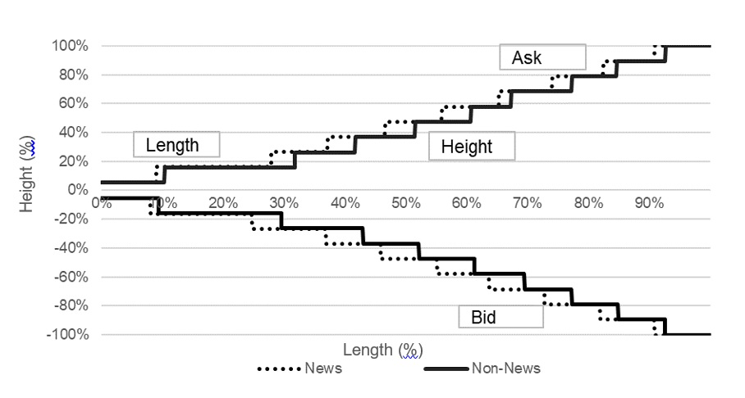
Shape of LOB – Corn
Notes:
The height of each step is the difference between the price in that step and the price in the previous step of the LOB.
The length of each step is the quantity of contracts associated with the price at that step.
Both height and length are normalized by the cumulative price difference and cumulative quantities, respectively (Cao et al. 2009).
For the first height, we use the arithmetic average of the best bid and best ask (MID).

Slide 9
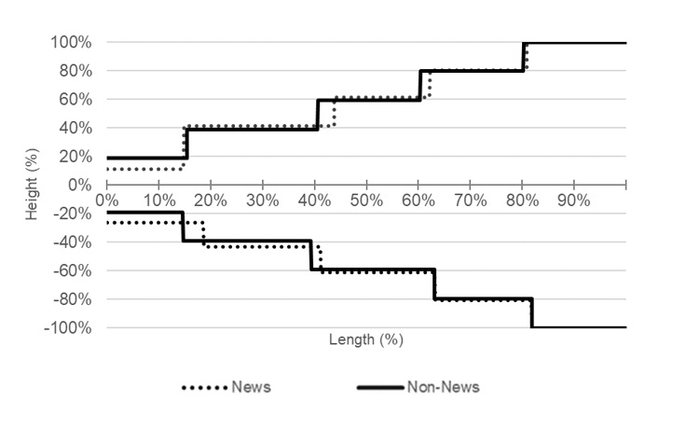
Shape of LOB – Live Cattle
Notes:
The height of each step is the difference between the price in that step and the price in the previous step of the LOB.
The length of each step is the quantity of contracts associated with the price at that step.
Both height and length are normalized by the cumulative price difference and cumulative quantities, respectively (Cao et al. 2009).
For the first height, we use the arithmetic average of the best bid and best ask (MID).

Slide 10
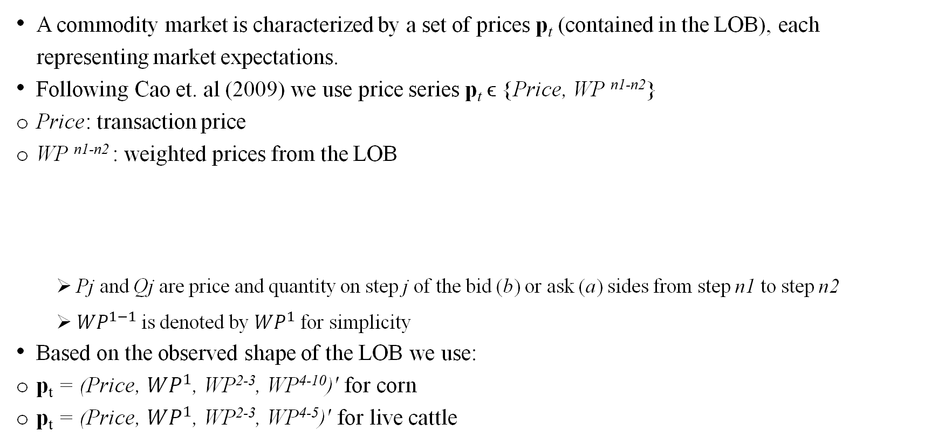
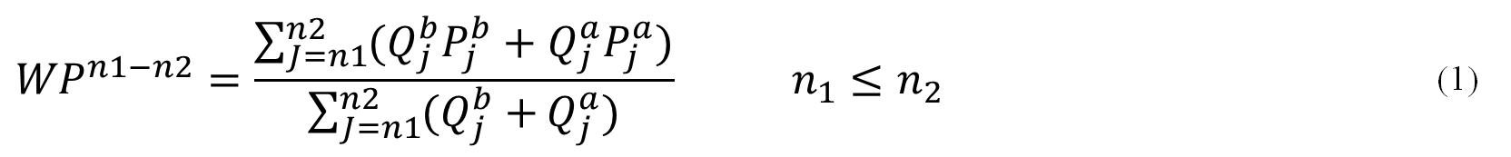
Measure of the LOB
A commodity market is characterized by a set of prices p_{t} (contained in the LOB), each representing market expectations.
Following Cao et. al (2009) we use price series p_{t} ϵ {Price, WP ^{n1-n2}}
Price: transaction price
WP ^{n1-n2} : weighted prices from the LOB
  Pj and Qj are price and quantity on step j of the bid (b) or ask (a) sides from step n1 to step n2
  ${WP}^{1−1}$is denoted by ${WP}^{1}$ for simplicity
Based on the observed shape of the LOB we use:
p_{t} = (Price, ${WP}^{1}$, WP²⁻³, WP⁴⁻¹⁰)' for corn
p_{t} = (Price, ${WP}^{1}$, WP²⁻³, WP⁴⁻⁵)' for live cattle
$${WP}^{n1−n2}=\frac{\sum_{J=n1}^{n2}{(Q_{j}^{b}P_{j}^{b}+Q_{j}^{a}P_{j}^{a})}}{\sum_{J=n1}^{n2}{(Q_{j}^{b}+}Q_{j}^{a})} n_{1}≤n_{2}$$ | (1)

Slide 11
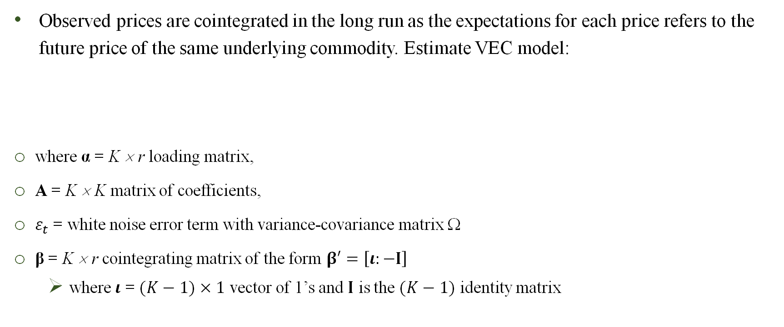
Method – Information Shares
Observed prices are cointegrated in the long run as the expectations for each price refers to the future price of the same underlying commodity. Estimate VEC model:
where α = K × r loading matrix,
A = K × K matrix of coefficients,
$ε_{t}$ = white noise error term with variance-covariance matrix Ω
β = K × r cointegrating matrix of the form $β′=\left[ι:−I\right]$
  where $ι$ = $(K−1)×1$ vector of 1’s and $I$ is the $(K−1)$ identity matrix
$$∆p_{t}=αβ^{′}p_{t−1}+\sum_{l=1}^{q}{A_{l}}∆p_{t−l}+ε_{t}$$ | (2)

Slide 12
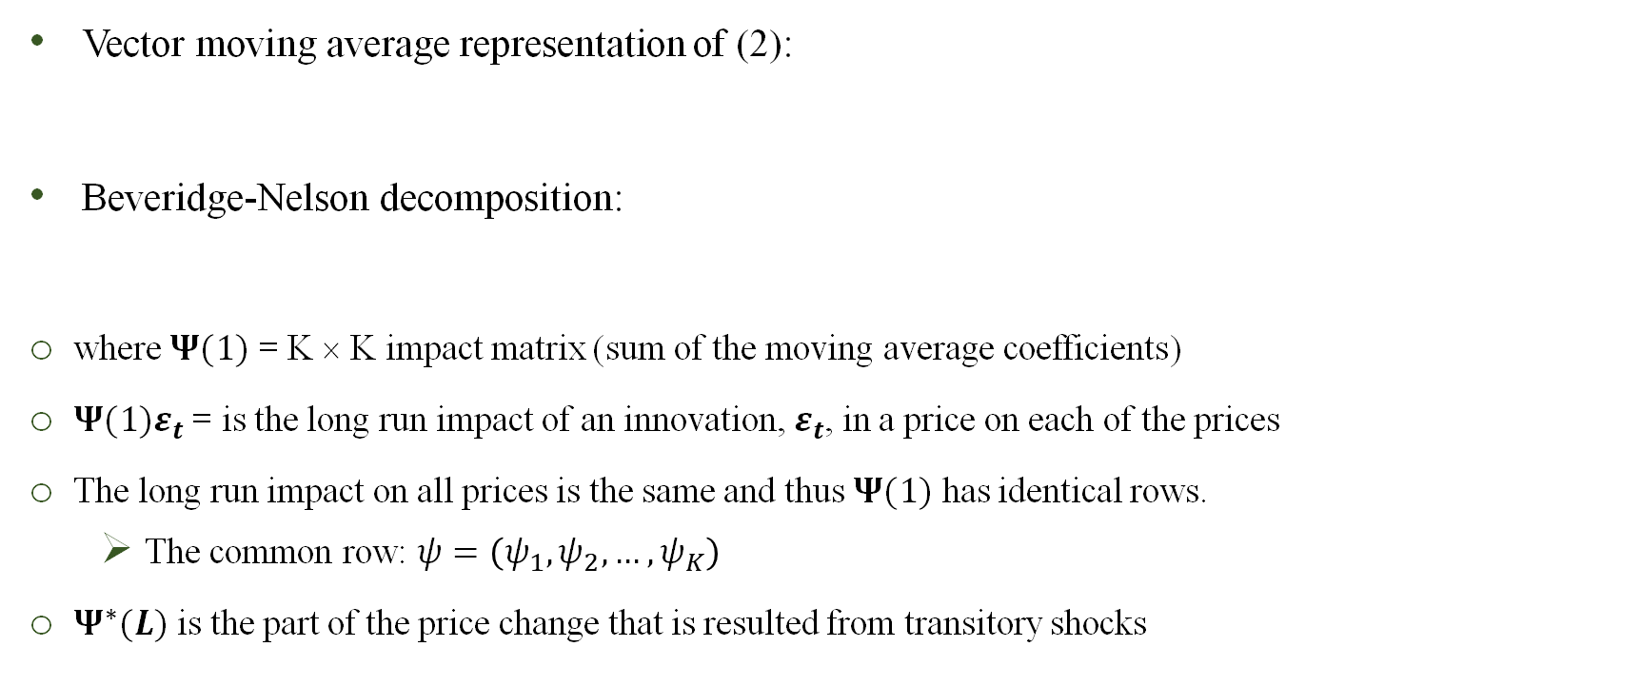
Method – Information Shares
Vector moving average representation of (2):
Beveridge-Nelson decomposition:
where $Ψ(1)$ = K × K impact matrix (sum of the moving average coefficients)
$Ψ(1)ε_{t}$ = is the long run impact of an innovation, $ε_{t}$, in a price on each of the prices
The long run impact on all prices is the same and thus $Ψ(1)$ has identical rows.
  The common row: $ψ=\left(ψ_{1}, ψ_{2},…,ψ_{K}\right)$
$Ψ^{∗}(L)$ is the part of the price change that is resulted from transitory shocks
$$∆p_{t}=Ψ_{0}ε_{t}+Ψ_{1}ε_{t−1}+Ψ_{2}ε_{t−2}+…$$ | (3)
$$p_{t}=p_{0}+Ψ(1)\sum_{i=1}^{t}{ε_{i}}+Ψ^{∗}(L)ε_{t}$$ | (4)

Slide 13
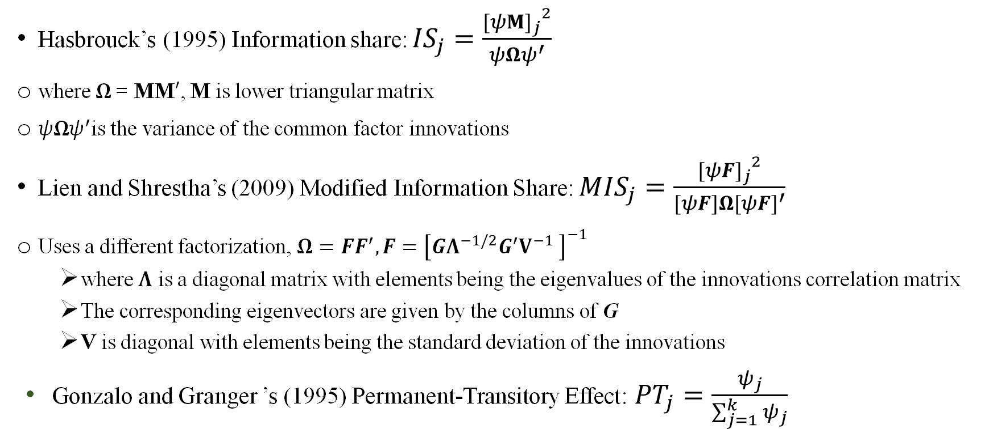
Method – Information Shares
Hasbrouck’s (1995) Information share: ${IS}_{j}=\frac{{{[ψM]}_{j}}^{2}}{ψΩψ^{′}}$
where $Ω$= MM$′$, M is lower triangular matrix
$ψΩψ^{′}$is the variance of the common factor innovations
Lien and Shrestha’s (2009) Modified Information Share: ${MIS}_{j}=\frac{{{[ψF]}_{j}}^{2}}{[ψF]Ω{[ψF]}^{′}}$
Uses a different factorization, $Ω=FF^{′}, F={\left[GΛ^{−1/2}G^{′}V^{−1} \right]}^{−1}$
  where $Λ$ is a diagonal matrix with elements being the eigenvalues of the innovations correlation matrix
  The corresponding eigenvectors are given by the columns of G
  V is diagonal with elements being the standard deviation of the innovations
Gonzalo and Granger ’s (1995) Permanent-Transitory Effect: ${PT}_{j}=\frac{ψ_{j}}{\sum_{j=1}^{k}{ψ_{j}}}$

Slide 14
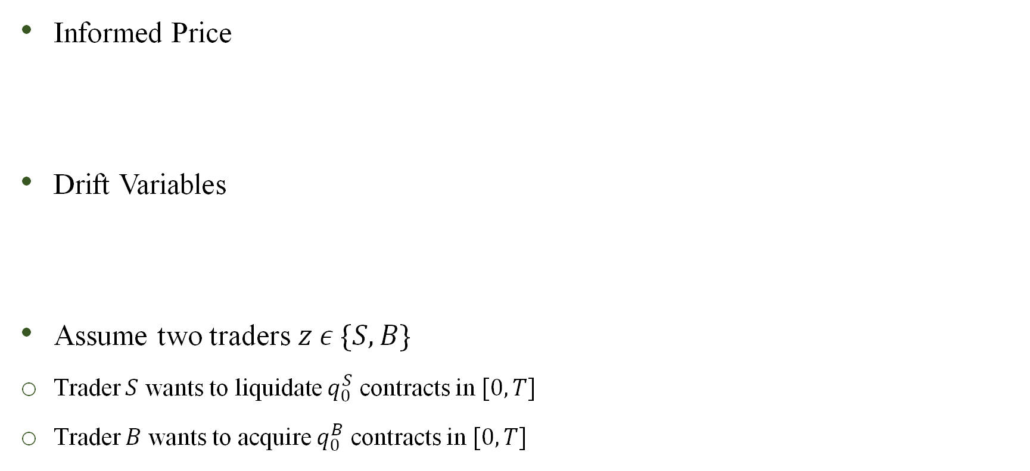
Method – Trading Scheme
Informed Price
Drift Variables
Assume two traders $z ε \{S, B\}$
Trader $S$ wants to liquidate $q_{0}^{S}$ contracts in $[0, T]$
Trader $B$ wants to acquire $q_{0}^{B}$ contracts in $[0, T]$
$$p_{t}^{l}=\sum_{k}{l_{t}^{k}k} ; l ε \left\{ISm, MIS, PT\right\}, k ε \{\text{Price}\text{, }{WP}^{1}\text{, }\text{WP}\text{2−3}\text{, }\text{WP}\text{4−10}\}$$ | (5)
$$D_{t}^{l,S}=p_{t}^{l}−P_{1,t}^{b}$$ | (6)
$$D_{t}^{l,B}=P_{1,t}^{a}−p_{t}^{l}$$ | (7)

Slide 15

Method – Trading Scheme
Inventory change at time t
where $v_{t}^{z}$ is the rate of liquidation or acquisition and $V_{t}^{S}≤v_{t}^{S}≤0$ and $0≤v_{t}^{B}≤V_{t}^{B}$
$V_{t}^{S}$ is the total number of contracts possible to liquidate – the LOB’s depth on the bid side
$V_{t}^{B}$ is the total number of contracts available to acquire – the LOB’s depth on the ask side
Trader $z$’s cash flow at time $t$ and her total cash flow at time $T$
$$dq_{t}^{z}=v_{t}^{z}dt$$ | (8)
$$d{CF}_{t}^{z}=−v_{t}^{z}𝒫_{t}^{z}dt$$ | (9)
$${CF}^{z}=\int_{0}^{T}{−v_{t}^{z}𝒫_{t}^{z}dt}$$ | (10)

Slide 16
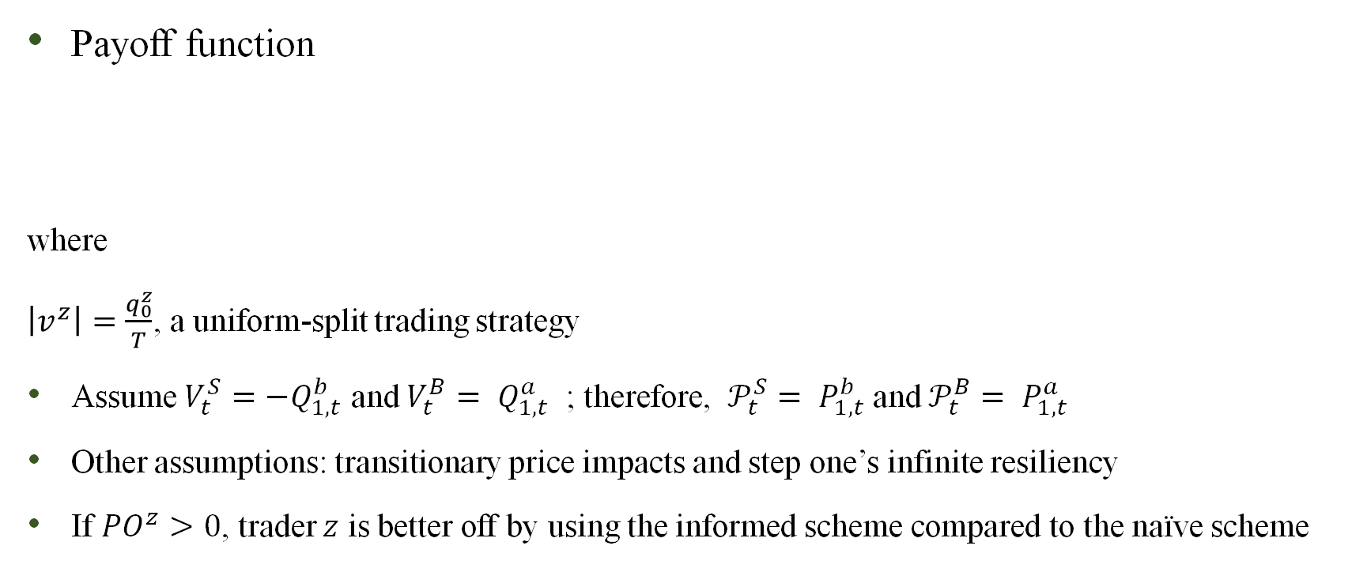
Method – Trading Scheme
Payoff function
where
$\left|v^{z}\right|=\frac{q_{0}^{z}}{T}$, a uniform-split trading strategy
Assume $V_{t}^{S}=−Q_{1,t}^{b}$ and $V_{t}^{B}= Q_{1,t}^{a}$ ; therefore, $𝒫_{t}^{S}= P_{1,t}^{b}$and $𝒫_{t}^{B}= P_{1,t}^{a}$
Other assumptions: transitionary price impacts and step one’s infinite resiliency
If ${PO}^{z}>0$, trader $z$ is better off by using the informed scheme compared to the naïve scheme
$${PO}^{z}=v^{z}\int_{0}^{T}{𝒫_{t}^{z}dt}−\int_{0}^{T}{v_{t}^{z}𝒫_{t}^{z}dt}$$ | (11)

Slide 17
Method – Empirical Procedure
We slice a 60-minute interval - around the USDA reports releases - from each of the 309 trading sessions
For corn the interval starts at 11:40 am ET and continues until 12:40 pm.
For live cattle, where the USDA reports are released outside trading hours, the 60-minute interval begins at the market open of the day after the reports are released
From each 60-minute interval, we take 10-minute windows where the first window starts at the start of the 60-minute interval and moves forward by one second for a total of 3,000 10-minute windows for each day
We estimate the VEC model in equation (2) for each of the 10-minute windows and compute the information shares for a total of 3,000 regressions and sets of information shares per day.
A frame-by-frame picture of the evolution of information shares of the price series around the USDA reports releases.
For each 10-minute window, the median information share of the price series are shown in the figures.

Slide 18
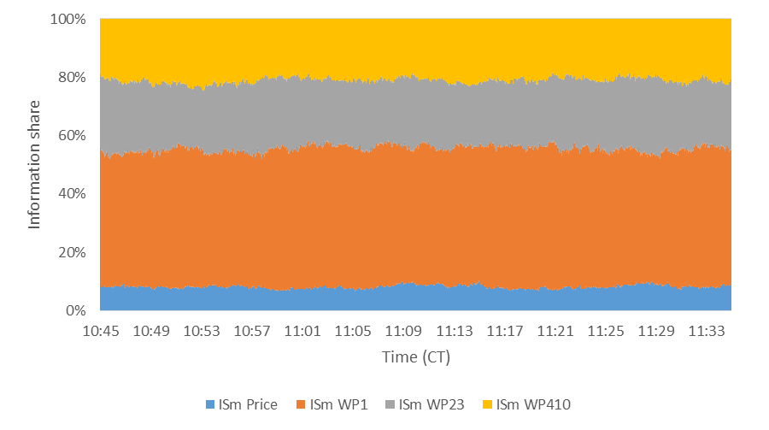
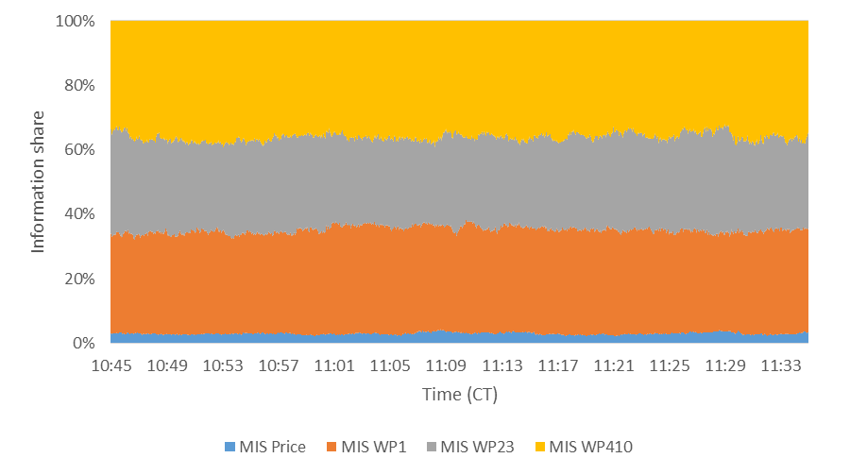
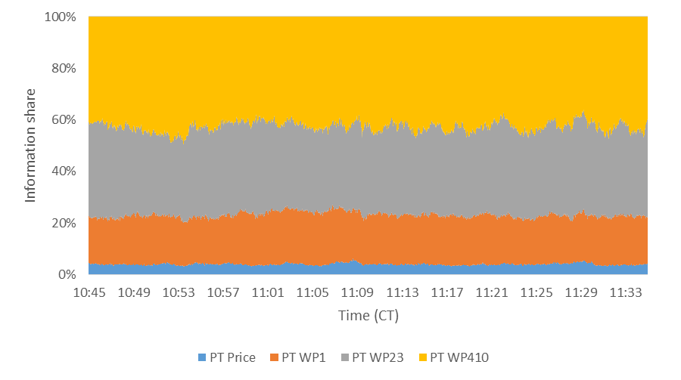
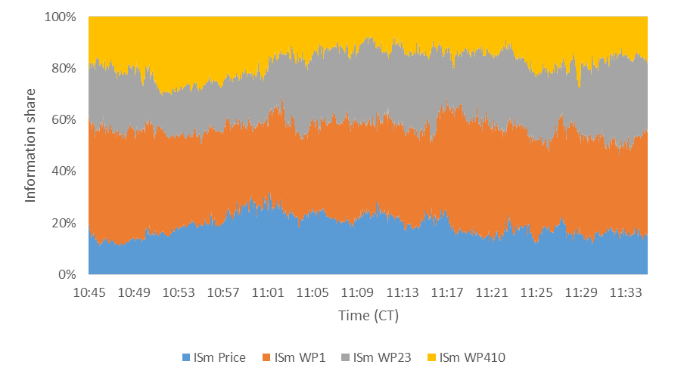
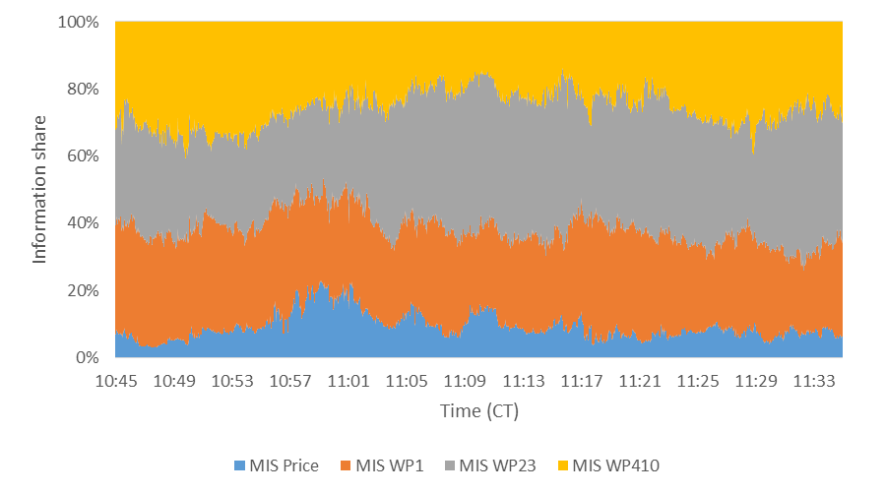
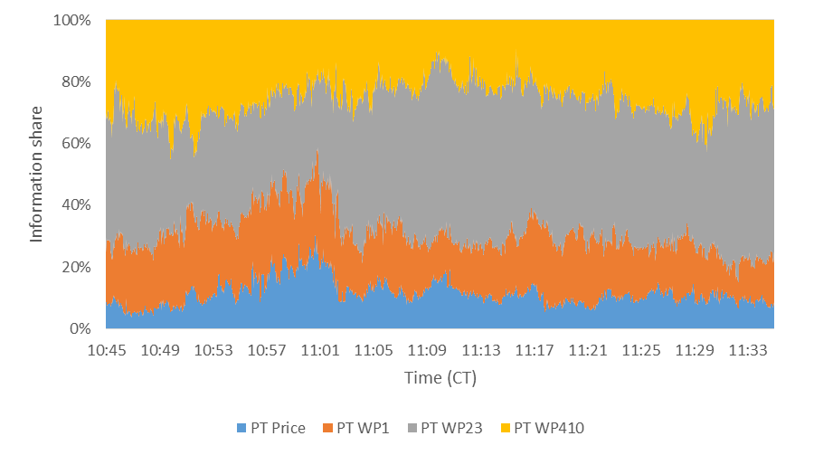
Results – Information Shares (Corn)
Non-News
News

Slide 19
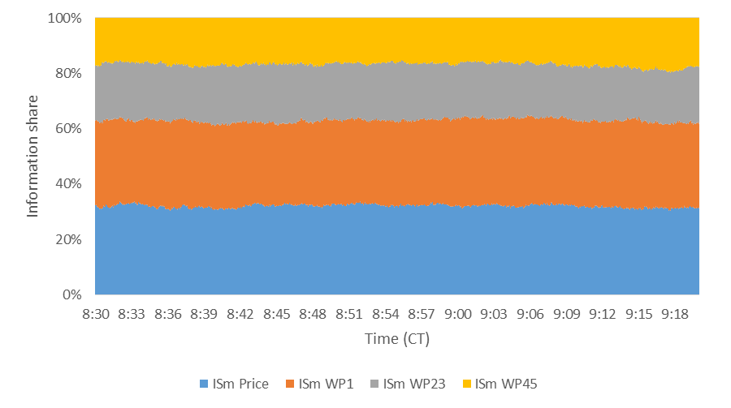
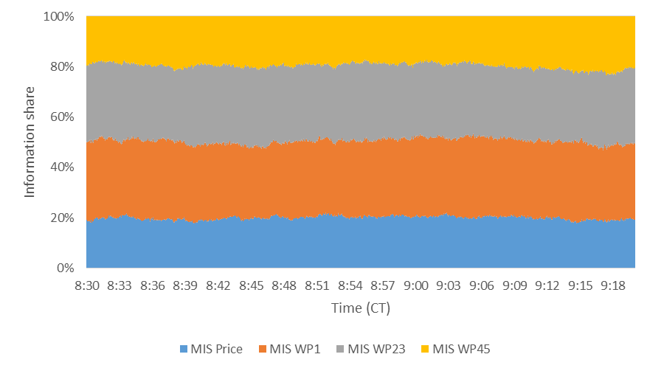

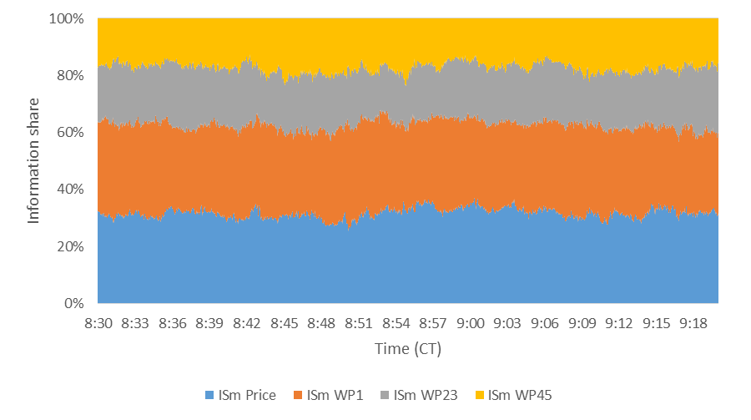
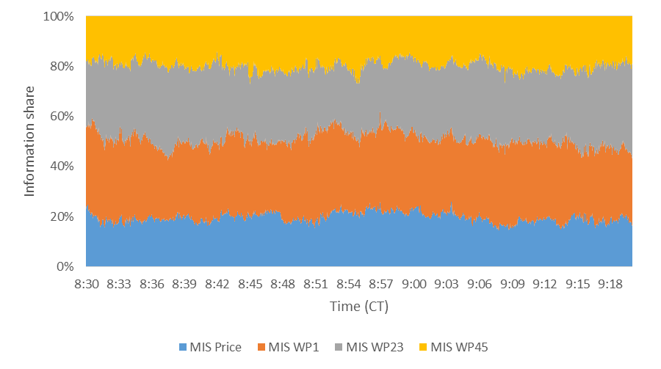
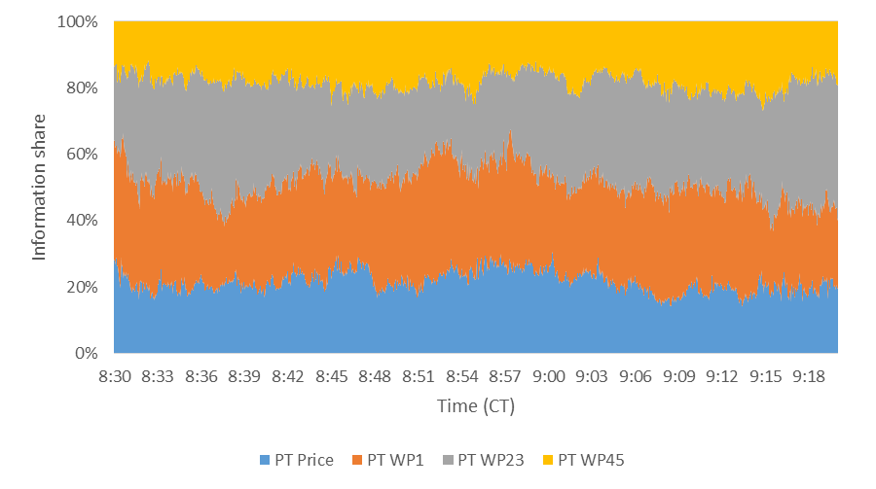
Results – Information Shares (Live Cattle)
Non-News
News

Slide 20
Results – Wilcoxon Rank-Sum Test
Corn
Live Cattle

Slide 21
Results – ISm (Corn)

Slide 22
Results – ISm (Live Cattle)

Slide 23
Results – MIS (Corn)

Slide 24
Results – MIS (Live Cattle)

Slide 25
Results – PT (Corn)

Slide 26
Results – PT (Live Cattle)

Slide 27

Results – Corn Trader $S$’s Payoff

Slide 28

Results – Corn Trader $B$’s Payoff

Slide 29

Results – Live Cattle Trader $z$’s Payoff

Slide 30
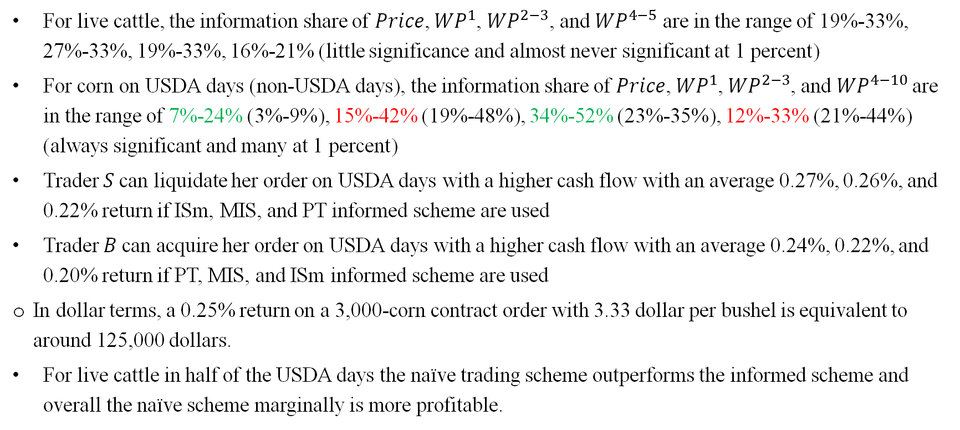
Results
For live cattle, the information share of 𝑃𝑟𝑖𝑐𝑒, ${WP}^{1}$, ${WP}^{2−3}$, and ${WP}^{4−5}$ are in the range of 19%-33%, 27%-33%, 19%-33%, 16%-21% (little significance and almost never significant at 1 percent)
For corn on USDA days (non-USDA days), the information share of 𝑃𝑟𝑖𝑐𝑒, ${WP}^{1}$, ${WP}^{2−3}$, and ${WP}^{4−10}$are in the range of 7%-24% (3%-9%), 15%-42% (19%-48%), 34%-52% (23%-35%), 12%-33% (21%-44%) (always significant and many at 1 percent)
Trader 𝑆 can liquidate her order on USDA days with a higher cash flow with an average 0.27%, 0.26%, and 0.22% return if ISm, MIS, and PT informed scheme are used
Trader 𝐵 can acquire her order on USDA days with a higher cash flow with an average 0.24%, 0.22%, and 0.20% return if PT, MIS, and ISm informed scheme are used
In dollar terms, a 0.25% return on a 3,000-corn contract order with 3.33 dollar per bushel is equivalent to around 125,000 dollars.
For live cattle in half of the USDA days the naïve trading scheme outperforms the informed scheme and overall the naïve scheme marginally is more profitable.

Slide 31
Conclusion
The relative depth decreases at the top of the book after the USDA announcements for corn while it increases for live cattle
USDA reports contain information that is incorporated into the underlying price of commodities more through transaction prices than the rest of the LOB
Informed traders become more aggressive in their strategies when new public information enters the market
On non-announcement days, the LOB is more informative
The arrival of news during trading session has a different impact on the price discovery mechanism than outside trading session
The informed trading scheme is on most USDA report days more profitable than the naïve scheme
When unwinding very large orders, the informed trading scheme does not outperform the naïve scheme for corn on non-USDA report days and for live cattle on USDA and on non-USDA days

Slide 32
Thank you!

