Slide 1
Drilling and DUCs in the Permian Basin
Asad Dossani and John Elder Colorado State Univ john.elder@colostate.edu
“If energy prices will trend higher, you invest one way; if energy prices will be lower, you invest a different way. But if you don’t know what prices will do, often you do not invest at all.”
Lawrence H. Summers, 2009.
“Uncertainty is seen to retard investment independently of considerations of risk or expected return. Introduction of uncertainty can be associated with slack investment, resolution of uncertainty with an investment boom.’
Ben Bernanke, 1979 PhD thesis

Slide 2
Contributions
Active literature on the response of oil production to oil demand shocks.
Monthly oil supply may be very inelastic (Killian 2009, Killian and Murphy 2014)
Monthly oil supply may be more elastic than you think (Baumeister and Hamilton, 2019, 2024)
This paper has some implications for speed of adjustment since 2014, or 2012.
Response of economic activity to uncertainty
Real options theory predicts higher uncertainty induces firms to postpone investment.
Firm level data output data is sparse. How about oil market?
DUCs can be used to postpone the largest investment.
We can estimate a relative focused response with data on wells and implied volatility.
Oil volatility is unique relative to SPX (Christofferson, Jacobs, Pan 2021))
Oil return SPD is U shaped, likely due to increasing uncertainty.
Oil SPD closely related to macro activity (IP, capital utilization).
Steeper Oil SPD reflects higher risk premia in equities, oil, other commodities (gold, copper, corn).
SPX SPD also neg correlated with macro activity, but no link large stock market returns and macro activity.

Slide 3
Oil Uncertainty - Theory and Evidence
Fernández-Villaverde and Guerrón-Quintana (2020) surveys extensive literature on equilibrium business cycle models of uncertainty shocks, suggesting focus on two sources - financial and macroeconomic.
Proxies for uncertainty include newspaper counts (Bloom, 2009) and composites (Jurardo et al 2015).
Chiang, Hughen, Sagi (2015)
Oil risk factors have risk premiums and are related to macro indicators.
Gao, Hitzeman, Shaliastovick and Xu (2022)
GE two-sector production model shows how OPU generates contractions.
Hitzemann (2016) examines effects of oil supply shocks on oil prices and risk prem in prod economy.
Alfaro, Bloom and Lin (2024, JPE)
GE heterogeneous firms model with real and financial frictions.
Show that financial frictions amplify, prolong, and propagate negative impact of uncertainty shocks.
Causal effects of energy, currency, and policy uncertainty estimated with novel IV strategy.
Uncertainty shocks causes declines in firms real activity (intangibles, employment, COGS, and sales).
Effects of uncertainty can largely be underestimated if endogeneity is left untreated.

Slide 4
Data and Sample
Data
We use data on monthly number of DUCs in Permian Basin exploring from EIA.
Oil prices measured by spot WTI (Alquist and Kilian (2010)).
Uncertainty measured by 1-month implied volatility from options on oil futures.
Baseline sample 2014 to 2020 to capture tightest link between prices and drilling.
Sample (2012-)
Surge in production not forecasted by EIA Energy Outlook or markets.
Oil field services firms experienced abnormal returns (Gilje, Ready, Roussanov 2016).
Rapid increases in technology and efficiency of hydraulic fracturing, multi-well pad drilling.
Notes:
Oil return SPD is U shaped - Both large negative and positive oil returns associated with bad econ states and high state prices (and high MU); may affect economy by increasing uncertainty,

Slide 5
Results
We find that DUCS tightly linked to both the level of oil prices and oil price uncertainty.
We describe institutional features around DUCS.
We show that DUCS respond relatively quickly to oil price shocks. This matters for a large literature on the propagation of oil shocks.
One std dev increase in oil price causes DUCS to decrease by about 5% after 2 months;
We do not measure barrels or calculate elasticities, and results are only relevant post 2014.
The DUC/Completion ratio declines by about 5% in response to rising uncertainty about oil prices
Robust to
Sample extended to include COVID (2022:04); recursive orderings.
Longer horizon implied volatility (6-month implied) Kilian and Luktepohl (2017)
Long lags (Bayesian with Minnesota prior shrinkage due to short sample)
Long run identifying restrictions – volatility does not affect DUC/completion ratio in long run.
Kilian, Plante, Richter (4/2024, WP)

Slide 6
Domestic Energy Extraction
Domestic (U.S.) horizontal oil and gas wells cost $5M-$8M?
Horizontal wells extract shale, tight formations and oil sands (eastern Utah).
Bakken, Permian, Eagle Ford, Appalachia (Marcellus).
Site preparation (~6% of costs onshore), such as road construction and surface equipment
storage tanks, separators and hook-up to gathering systems.
Drilling (~31% costs) to total depth with a rig.
Casing, liner, drill bits, rig hire fees, cement, mud and drilling fluids and fuel costs.
Completion (~63% costs) by frack crews and a workover rig.
Well perforations, fracking and fluid supply and disposal.
Firms hold inventory of Drilled but Uncompleted Wells.
Operating activities consist of well maintenance and occasional workover activities and other costs up to the point of shipment from the producing property.

Slide 7
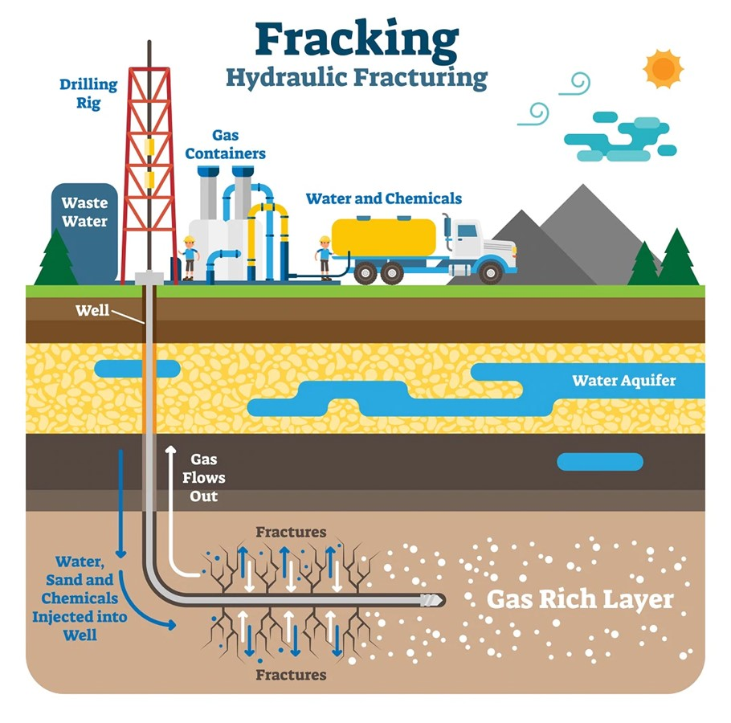
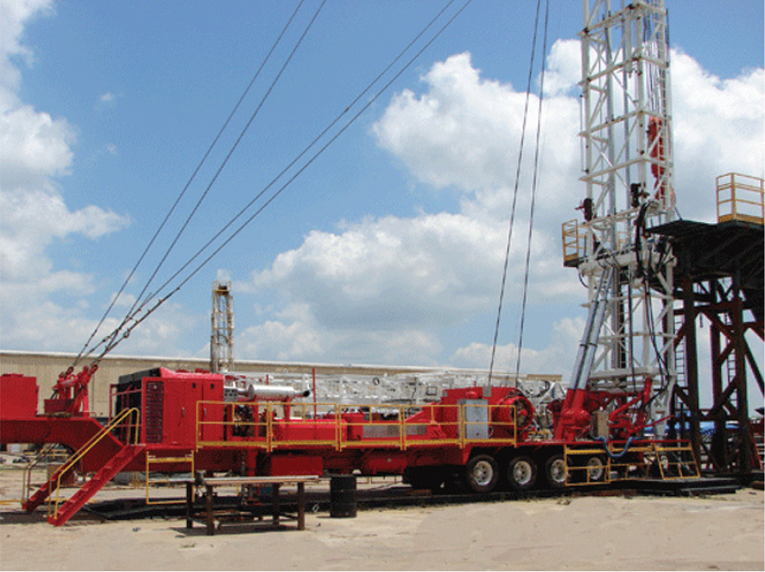
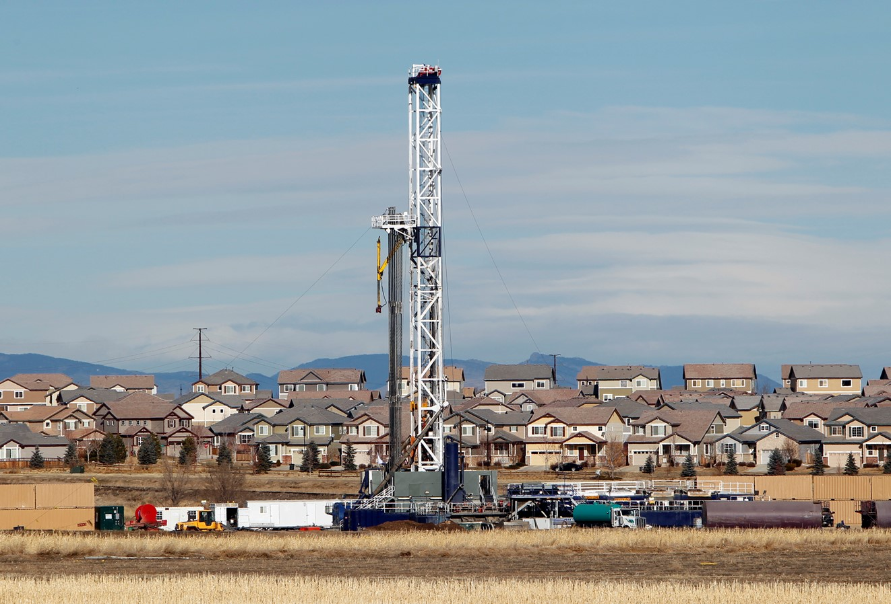

Slide 8
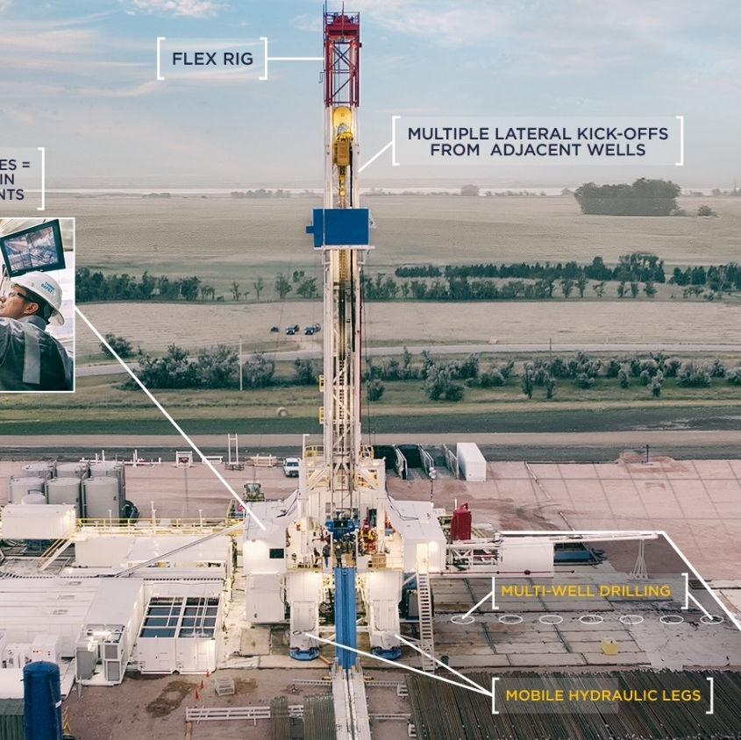
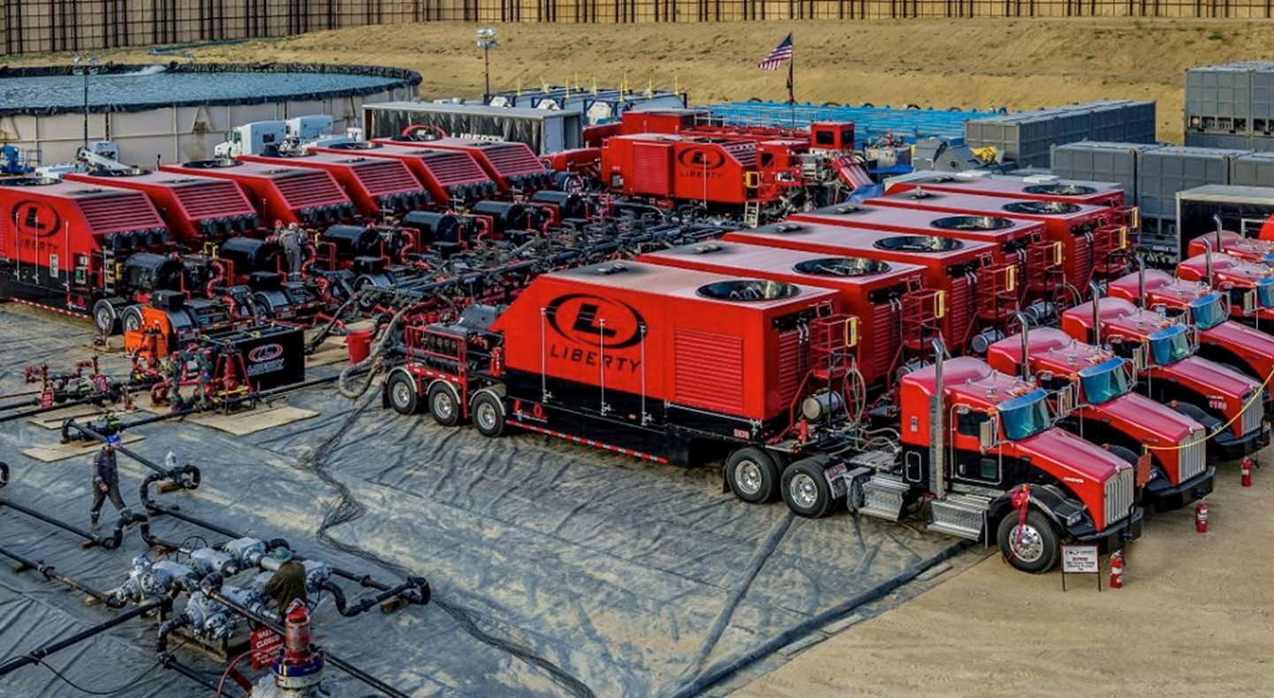
Notes:
Some producers have up to 64 wells on a pad.

Slide 9
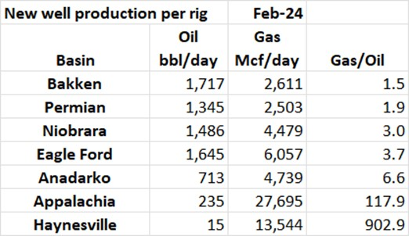
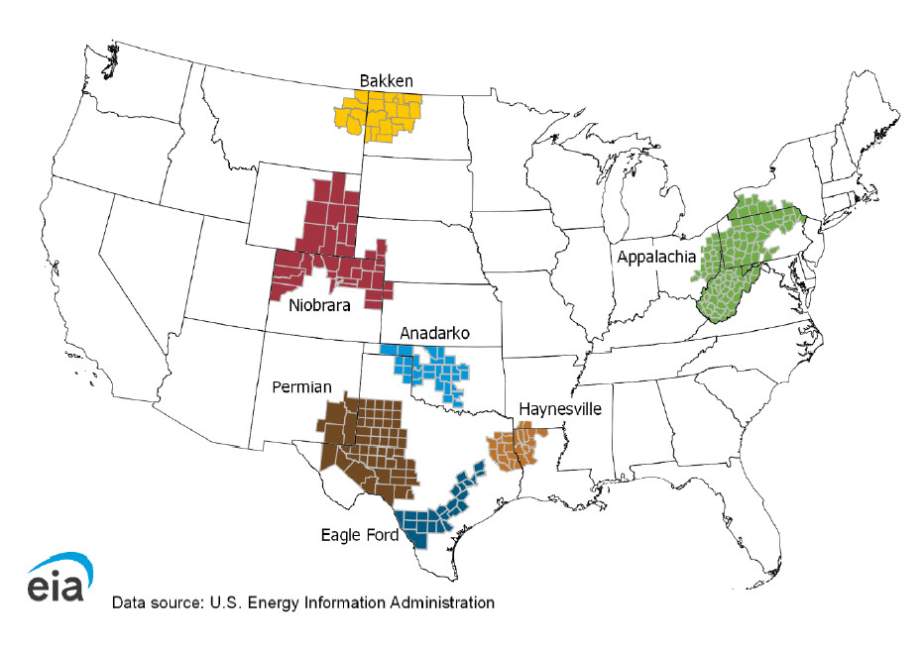
Drilled but uncompleted wells by regions
Sample should start after 2012 (multi-pad drilling)
DUCs grouped by region - should produce mostly oil

Slide 10
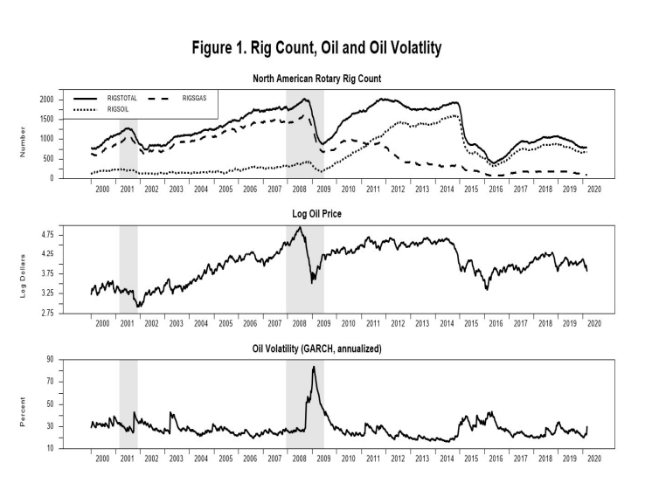

Slide 11
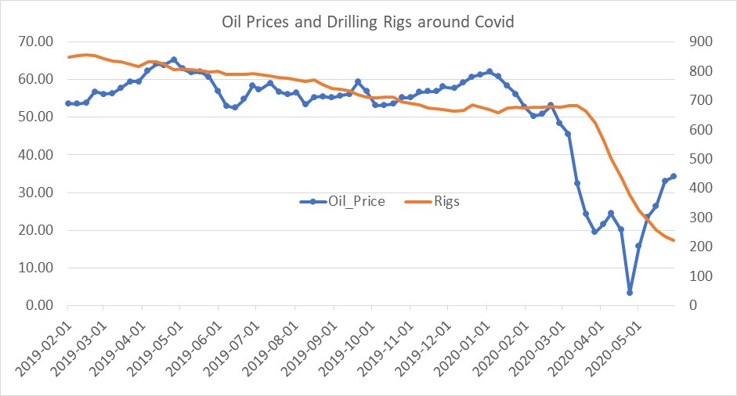
Oil Prices and Drilling Rigs during Covid

Slide 12
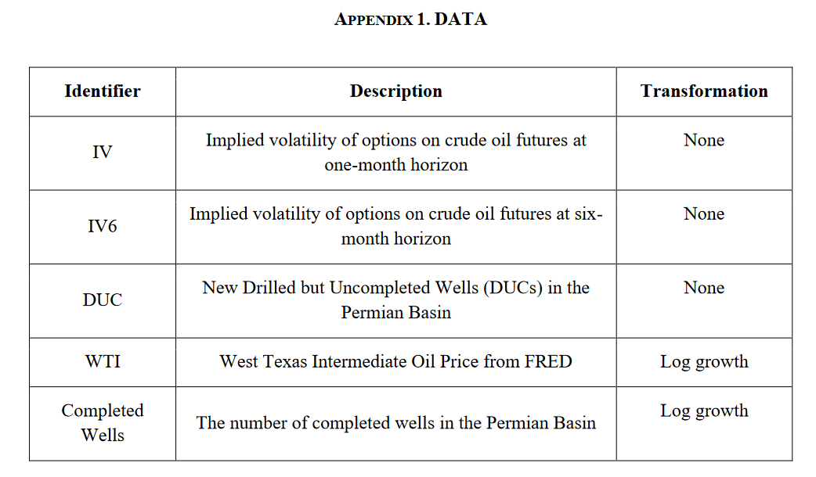

Slide 13
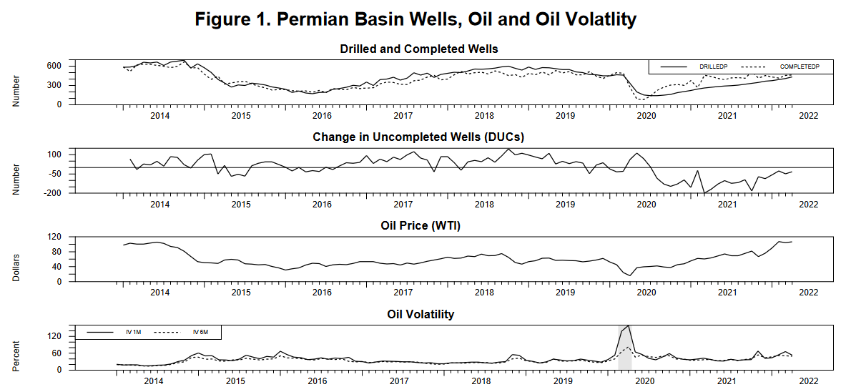
Notes:
Notes: Permian Basin drilled and completed wells, change in uncompleted wells, oil prices and oil volatility as implied volatility from Chicago Board Options Exchange.

Slide 14
Empirical Model
Vector Autoregession
Measure oil volatility by implied volatility from options on oil futures.
Flexible empirical model that summarizes relevant dynamics and captures uncertainty effect.
Goal is to identify an uncertainty shock, orthogonal to contemporaneous information set.
Oil volatility is variance of the forecast error, conditional on contemporaneous information set.
Simple identifying restrictions.
By_{t} = C + Γ₁y_{t–1} + Γ₂y_{t–2} + ··· + Γ_{p}y_{t–p} + ε_{t},
$y_{t}= \left[\begin{matrix}{DUCs}_{t} \\ \begin{aligned}{Completions}_{t} \\ {Vol}_{t}\end{aligned} \\ {Oil}_{t}\end{matrix}\right]$ with recursive identification for homoscedastic VAR.
$y_{t}= \left[\begin{matrix}{DUCs}_{t}/{Comps}_{t} \\ \begin{aligned}{Vol}_{t} \\ {Oil}_{t}\end{aligned} \\ \end{matrix}\right]$.

Slide 15
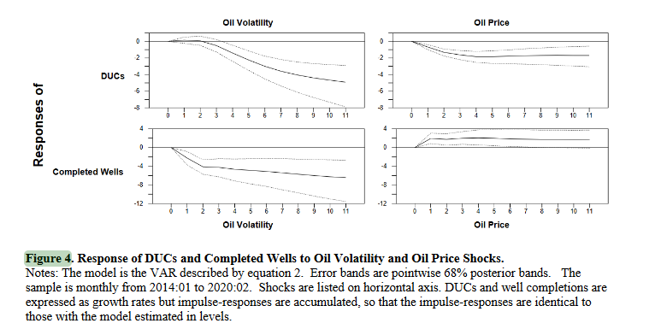
Notes:
DUCS drawn down, but completed wells are falling even faster. Contracts may be forcing rigs to keep turning. More relevant is ratio.

Slide 16
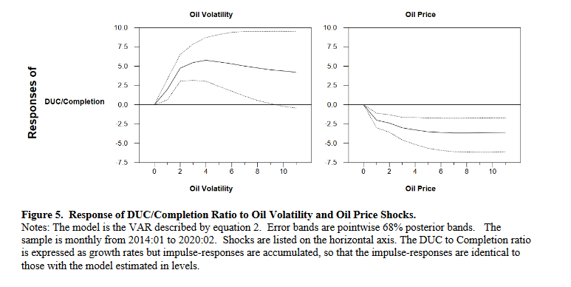

Slide 17
Tests of Robustness
Robust to
Sample extended to include COVID (2022:04)
Ordering (volatility ordered last)
Longer horizon implied volatility (6-month implied)
Kilian and Luktepohl (2017)
Long lags (Bayesian with Minnesota prior shrinkage due to short sample)
Long run identifying restrictions – volatility does not affect DUC/completion ratio in long run.
Kilian, Plante, Richter (4/2024, WP) Macroeconomic Responses to Uncertainty Shocks: The Perils of Recursive Orderings

Slide 18
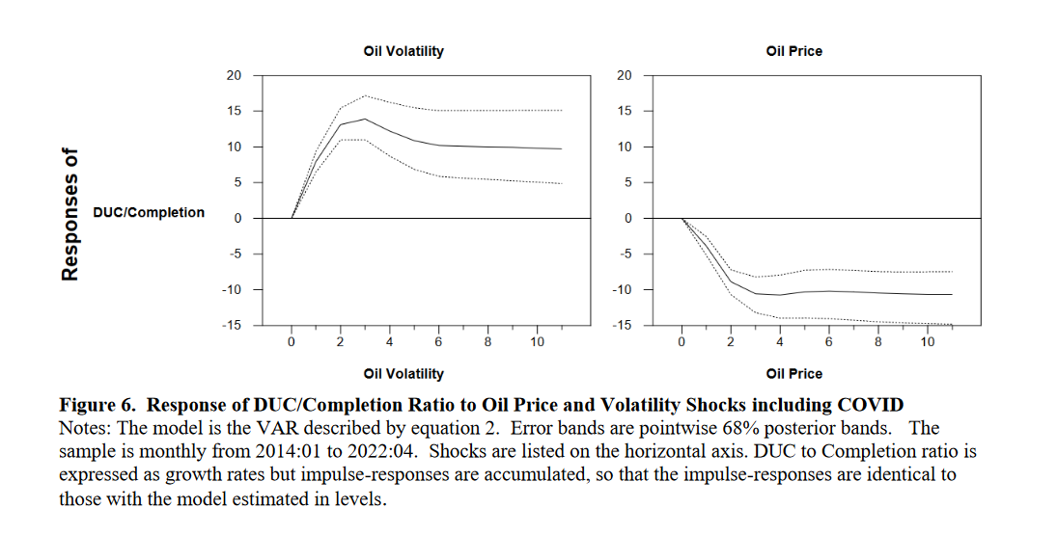

Slide 19
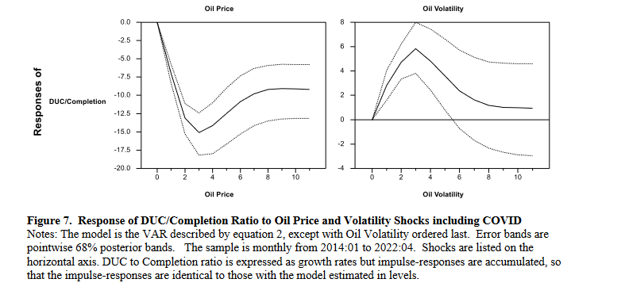

Slide 20
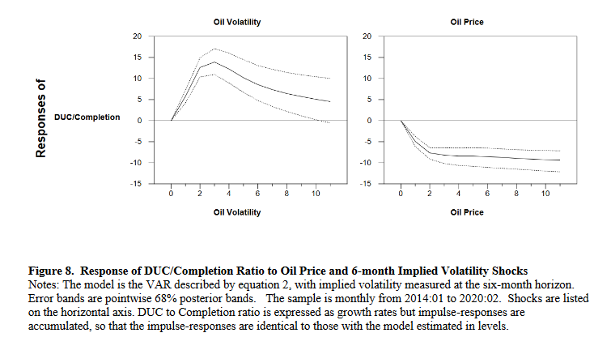

Slide 21
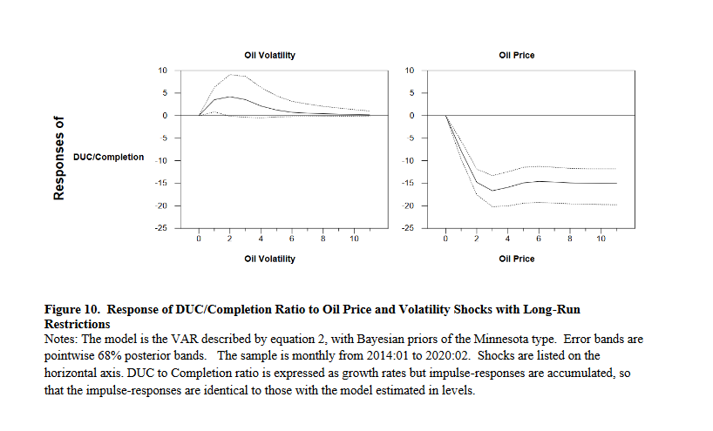

Slide 22
Conclusions
We find that DUCS tightly linked to both the level of oil prices and oil price uncertainty.
We describe institutional features around DUCS.
We show that DUCS respond relatively quickly to oil price shocks. This matters for a large literature on the propagation of oil shocks.
One std dev increase in oil price causes DUCS to decrease by about 5% after 2 months;
We do not measure barrels of output or calculate elasticities. Our results are only relevant post 2014.
The DUC/Completion ratio declines by about 5% in response to rising uncertainty about oil prices
Robust to
Sample extended to include COVID (2022:04); recursive orderings.
Longer horizon implied volatility (6-month implied) Kilian and Luktepohl (2017)
Long lags (Bayesian with Minnesota prior shrinkage due to short sample)
Long run identifying restrictions – volatility does not affect DUC/completion ratio in long run.
Kilian, Plante, Richter (4/2024, WP)

Slide 23
