Slide 1
Expected Skewness, Forecast Combinations, and Commodity Futures Returns
Jun Cai, Bart Frijns, and Robert Webb
2024 New Directions in Commodities Research Symposium
13 August 2024
© 2024

Slide 2
What Does This Paper Do?
Examines whether expected skewness helps explain returns in the commodity futures market.
Our study examines commodity market data rather than equity market data.
Why?
Avoids data mining charge of Harvey et al [2016]
Surpasses the higher statistical significance threshold Harvey et al [2016] suggest for new factors.

Slide 3
Motivation: Skewness and Behavioral Finance
Individuals exhibit a preference for skewness in their investments.
Mitton and Vorkink [RFS 2007]
investors have a preference for skewness and
under-diversify their equity portfolios.

Slide 4
Motivation: Skewness and Behavioral Finance
Barberis and Huang [AER 2008] advance a model based on the implications of cumulative prospect theory (CPT) where:
“a security's own [expected] skewness can be priced:
“a positively skewed security can be "overpriced" and can earn a negative average excess return.”
They argue CPT investors prefer skewness.

Slide 5
Motivation: Skewness and Asset Pricing
Harvey and Siddique [JF 2000] argue that investors should be compensated for bearing systematic skewness risk and advance an asset pricing model with conditional skewness as a risk factor.
They report: “Systematic skewness is economically important and commands a risk premium, on average, of 3.60 percent per year.”

Slide 6
Motivation: Skewness in Equity Markets
Empirical evidence on skewness is mixed and comes mainly from the equity market.
Boyer, Mitton, and Vorkink, [2010] report “expected idiosyncratic skewness and expected returns are negatively correlated”
Bali et al., [2011] report evidence of “a negative and significant relation between the maximum daily return over the past one month (MAX) and expected stock returns.” They argue their results are not consistent with expected skewness or co-skewness.

Slide 7
Motivation: Commodity Markets
One of the implications of Barberis and Huang [AER 2008] is that expected skewness has pricing power in financial markets. What is the evidence in the commodity markets?
There is growing evidence that commodity investment strategies based on commodity futures characteristics and contract specific characteristics, generate highly significant long-short hedge portfolio returns.

Slide 8
Motivation: Commodity Markets
Some of the sources of highly significant long-short hedge portfolio returns are:
Momentum, contrarian return, idiosyncratic volatility, and skewness…
Basis, basis momentum, and hedging pressure…
Miffre and Rallis (2007), Bianchi et al. (2015), Asness et al. (2013), Szymanowska et al. (2014), Fuertes et al. (2015), Fernandez-Perez et al. (2018), and Bakshi et al. (2019);
Gorton et al. (2013), Yang (2013), Basu and Miffre (2013), Dewally et al. (2013), Boon and Prado (2019), De Noon et al. (2000).

Slide 9
Motivation: Commodity Markets
Existing literature also suggests that the one-month lagged value of skewness in a commodities futures contract turns out to be one of the most important characteristics that can reliably predict commodity futures returns (Fernandez-Perez et al., [2018]).
There is no empirical evidence relating expected skewness, which is ex-ante in nature, to commodity futures contract returns

Slide 10
Motivation: Commodity Markets
The number of commodity futures contracts employed in empirical studies is usually between 30 and 40, which is much smaller compared to the number of stocks in the equity market.
This makes it difficult to simultaneously include all futures contract characteristics in the cross-sectional regressions, either in predicting contract returns or predicting skewness.
Forecast combination approach could help resolve the issue (Bates and Granger, 1969; Timmermann, 2006; Rapach et al., 2010; Huang et al., 2021).

Slide 11
Research Questions
Questions on the pricing implications of expected skewness in commodity futures markets include:
What are the cross-sectional determinants of skewness (with or without lagged skewness)?
How well can we predict expected skewness?
How does expected skewness relate to commodity futures contract returns in the cross-sectional regressions? How about hedge portfolio returns and alphas of factor models?
Would the pricing implications change if we use the forecast combination approach?

Slide 12
Main Findings
The performance of the skewness prediction model for commodity futures market is much better than the performance of the skewness prediction model for the U.S. equity market.
When we use three-(six-)month lagged skewness and other contract characteristics to predict skewness in a monthly cross-sectional regression, the average estimated coefficient of lagged skewness is around 0.73(0.50) with a Fama-MacBeth (1973) t-statistic around 50(30). The R²s are around 0.70(0.50);

Slide 13
Main Findings
When we exclude lagged skewness, other factors become more important in predicting skewness. the R²s range from 0.25 to 0.32, about half the size of R²s from models including lagged skewness.
R²s for equity markets are between 0.03 and 0.082 in various model specifications.
Expected skewness is reliably and negatively related to futures returns.
We run Fama-MacBeth cross-sectional regressions of commodity futures R_{i,t+1} returns on expected skewness.

Slide 14
Main Findings
The performance of our ex-ante measures of skewness is as good as the performance of lagged skewness, which is a proxy for ex-ante skewness, in predicting futures returns.
Sorting on expected skewness also generates large and highly significant long-short hedge portfolio returns ranging from -1.269% to -0.945% per month. The alphas relative to a four factor model ranges from -1.149% to -0.745% per month. All of them are highly significant.

Slide 15
Main Findings
As a comparison, sorting on lagged skewness generates a long-short hedge portfolio return of -1.182% per month. The corresponding highly significant alpha is -1.013% per month.
Results from the forecast combination approach are similar to the results from the traditional approach of using alternative sets of factors.

Slide 16
Main Findings
The average estimated coefficient of expected skewness on commodity futures returns (t-stat.) are -0.475 (-2.82), -3.147 (-3.25), and -2.263 (-3.40), respectively. The long-short hedge portfolio returns are -0.991 (-3.77), -1.188 (-4.05), and -1.153 (-3.89). The alphas relative to a four-factor model are -0.850, -0.846, and -0.822, respectively. All of them are highly significant.

Slide 17
Data
34 commodity futures contracts that fall into the following five major categories - energy, grains and oilseeds, livestock, metals, and softs;
Period of 198701-202206;
S&P Goldman Sachs commodity total return indices (GSCI) and futures contracts data on individual commodity futures
From DATASTREAM and webpage of Commodity and Futures Trading Commission.

Slide 18
Data
Key Commodity Futures Contract Characteristics:
Skewness (SKEW), 12-month momentum (MOM12), 36-month contrarian return (CTR36), idiosyncratic volatility (IVOL), trading volume (VOLM), open interest (OPNI), basis (BASIS), 12-month basis momentum (BASM12), speculating pressure (HPSP), and hedging pressure (HPHE).

Slide 19
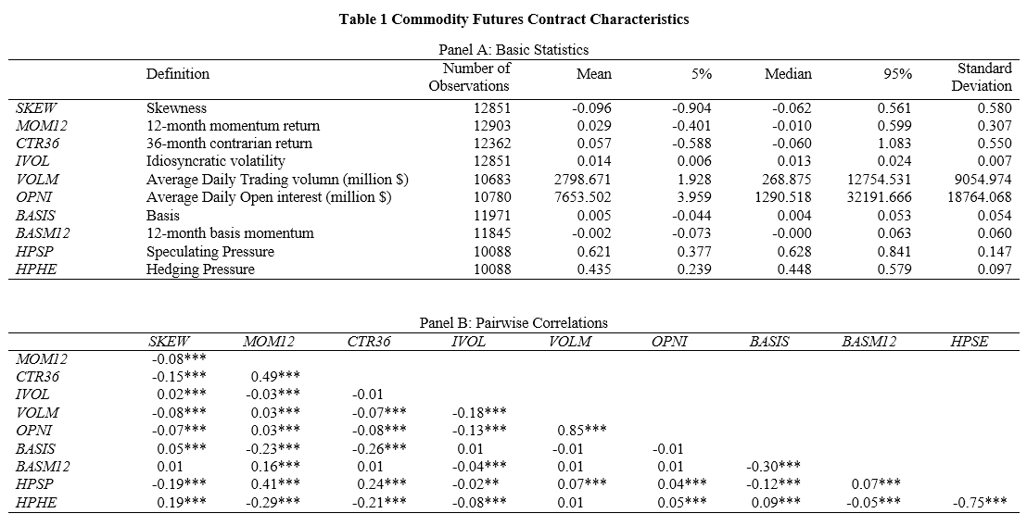
Empirical Analysis—Table 1

Slide 20
Table 1: Summary Statistics
Panel A shows that the mean (median) value of SKEW is -0.096 (-0.062). The mean value of MOM12 is 0.029, or 2.9% per month.
Panel B reports the pairwise correlations among selected variables. The correlation between SKEW and HPSP is the most negative, -0.19, and highly significant. The correlation between SKEW and HPHE is the most positive, 0.19, and highly significant.

Slide 21

Empirical Analysis
Predicting Skewness Using Lagged Information
In the case of three-month lagged skewness
With lagged skewness
Without lagged skewness
$$SKEW_{i,t}=γ_{0,t}+γ_{1,t}SKEW_{i,t−3}\text{+}γ_{2,t}^{′}Z_{i,t−3}\text{+}ε_{i,t}\text{, }$$
$$ESKEW_{i,t+1}={\hat{SKEW}}_{i,t+1}={\hat{γ}}_{0,t}+{\hat{γ}}_{1,t}SKEW_{i,t−2}\text{+}γ_{2,t}^{′}Z_{i,t−2}\text{, }$$
$$SKEW_{i,t}=δ_{0,t}+δ_{1,t}^{′}Z_{i,t−3}\text{+}ε_{i,t}\text{, }$$
$$ESKEW_{i,t+1}={\hat{SKEW}}_{i,t+1}={\hat{δ}}_{0,t}+{\hat{δ}}_{1,t}^{′}Z_{i,t−2}\text{, }$$

Slide 22
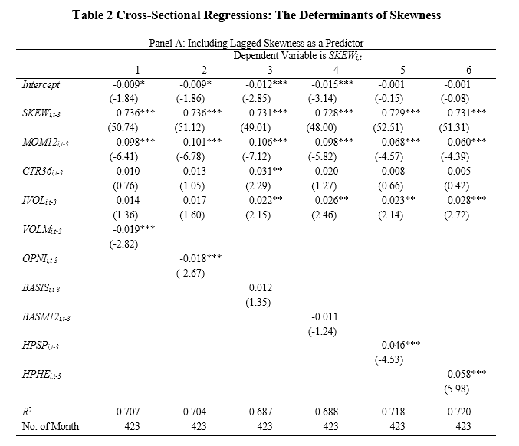
Empirical Analysis—Table 2A—3 Month
3-month lagged

Slide 23
Table 2A: Panel A with 3 Month Lagged Skewness
The first six columns in Panel A include three-month lagged skewness, SKEW_{i,t-3}, as in Equation (1). Then the first six columns in Panel A include one of the following contract characteristics one at a time: VOLM_{i,t-3}, OPNI_{i,t-3}, BASIS_{i,t-3}, BASM12_{i,t-3}, HPSP_{i,t-3}, and HPHE_{i,t-3}.
The estimated coefficients on SKEW_{i,t-3} range from 0.728 to 0.736 with t-statistics around as large as around 50.
The estimated coefficients (t-stats) on HPSP_{i,t-3} and HPHE_{i,t-3} are -0.046 (-4.53) and 0.058 (5.98), respectively. Therefore, SKEW is significantly related to three-month lagged measures of skewness, trading volume, open interest, speculation pressure, and hedging pressure.
The R²s are high, ranging from 0.687 to 0.720. The highest R²s are from the two models that include lagged measures of HPSP and HPHP, respectively.

Slide 24
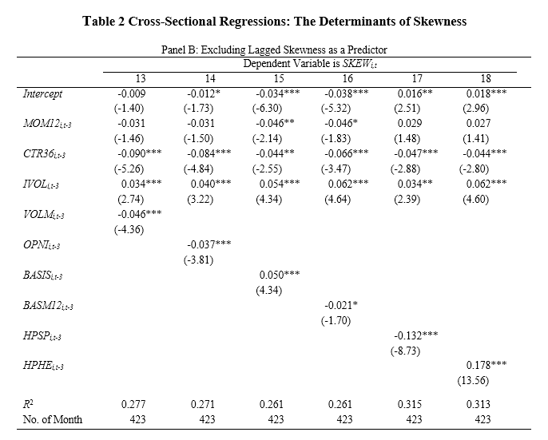
Empirical Analysis—Table 2B—3 Month
No 3-month lagged

Slide 25
Table 2B: Panel B Excluding Lagged Skewness
In Panel B, we exclude lagged skewness and rely only on the rest of the nine contract characteristics to predict skewness. The first six columns in Panel B show that the significant predictors include CTR36_{i,t-3}, IVOL_{i,t-3}, VOLM_{i,t-3}, OPNI_{i,t-3}, BASIS_{i,t-3}, HPSP_{i,t-3}, and HPHP_{i,t-3}. In general, these characteristics are associated with larger estimated coefficients and large t-statistics in absolute value when compared with the results in the first six columns in Panel A. The R²s range from 0.261 to 0.315, which are less than half of the R²s from models including lagged skewness.

Slide 26
Table 2B-Panel B
We can draw the same conclusions from the next six columns of Panel B. The highest R²s are still from the two models that include lagged measures of HPSP and HPHP.
From Panel A, the drop in R² using 6-month lagged skewness instead of using 3-month lagge is about 19%. On the other hand, the drop in R²s using 6-month lagged values of other contract characteristics instead of using 3-month lagged values is negligible.
Three-month lagged skewness is much more informative about future skewness than six-month lagged skewness. 3 and 6 month lagged values of other characteristics are equally informative of future skewness.

Slide 27
Models of Expected Skewness
There are a total 24 models reported in Table 2 for the prediction of future skewness. To conserve space, we use monthly estimated coefficients from eight models to construct expected skewness.
Table 3 provides summary statistics for skewness and expected skewness. Notice that skewness is measured using information at time t. The expected skewness is also constructed using information at time t. The expectation is for month t+1.

Slide 28
Models of Expected Skewness
Panel A shows that the standard deviation of expected skewness constructed using both lagged skewness and lagged values of other characteristics are larger than that of expected skewness constructed using lagged values of other characteristics only.
Panel B shows that the correlations between skewness and expected skewness constructed using both lagged skewness and lagged values of other characteristics are larger than that of expected skewness constructed using lagged values of other characteristics only.

Slide 29
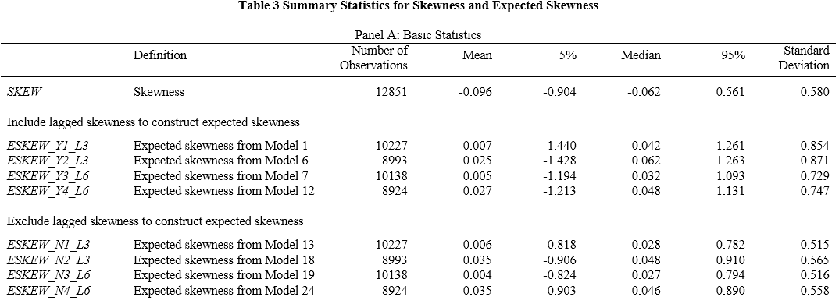
Empirical Analysis—Table 3A

Slide 30
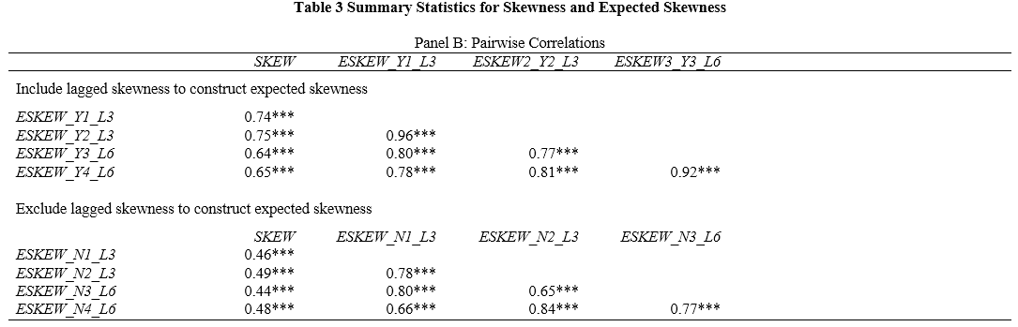
Empirical Analysis—Table 3B

Slide 31
Commodity Futures Contract Returns, R_{i,t+1}, and Various Contract Characteristics
Table 4 summarizes the average coefficient (t-statistic) from Fama-MacBeth (1973) monthly regressions of 34 commodity futures contract monthly returns on contract characteristics. Table 4 contains eight model specifications.
Two characteristics, SKEW_{i,t} and MOM12_{i,t}, are always included in the regressions. Then, Table 4 adds each of the following eight characteristics CTR36_{i,t}, IVOL_{i,t}, VOLM_{i,t}, OPNI_{i,t}, BASIS_{i,t}, BASM12_{i,t}, HPSP_{i,t}, and HPHE_{i,t} one at a time.
There is clear evidence that among the 10 commodity futures contract characteristics, skewness is the most important characteristic that predict futures contract returns.

Slide 32
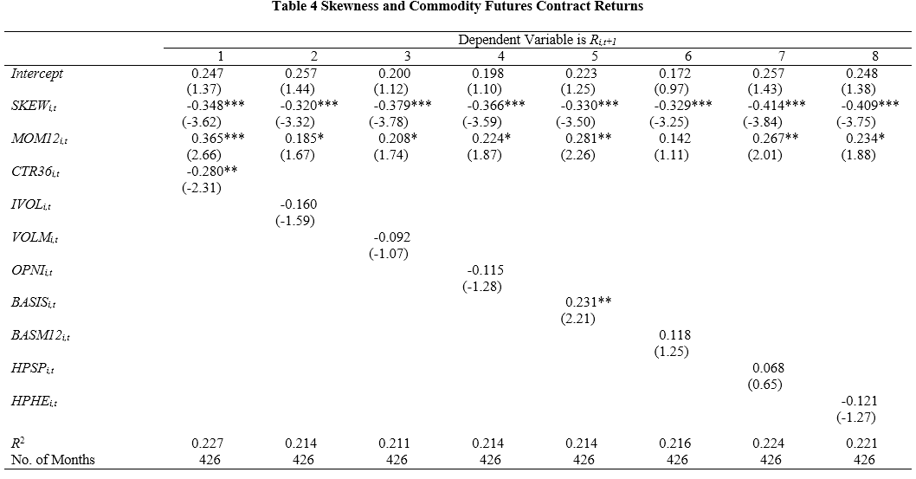
Empirical Analysis—Table 4

Slide 33
Expected Skewness and Commodity Futures Contract Returns
Our primary objective is to examine the relation between expected skewness for time t+1 measured using information available at time t and commodity future contract returns at time t+1.
Table 5 presents the results when expected skewness is constructed using both lagged skewness and lagged values of other characteristics as predictors.
Table 6 presents the results when expected skewness is constructed using only lagged values of other characteristics as predictors.

Slide 34
Table 5: Panel A
Panel A includes two measures of expected skewness constructed using predictors with a lag of three months: ESKEW_Y1_L3_{i,t} and ESKEW_Y2_L3_{i,t}. The cross-sectional regressions add one of the following six contract characteristics one at a time: VOLM_{i,t}, OPNI_{i,t}, BASIS_{i,t}, BASM12_{i,t}, HPSP_{i,t}, and HPHE_{i,t}.
Panel A of Table 5 shows that expected skewness for time t+1 is related to commodity futures contract returns at time t+1 in a reliable way. The estimated coefficients for ESKEW_Y3_L3_{i,t} range from -0.533 to -0.366. The corresponding t-statistics range from -3.51 to -2.41.

Slide 35
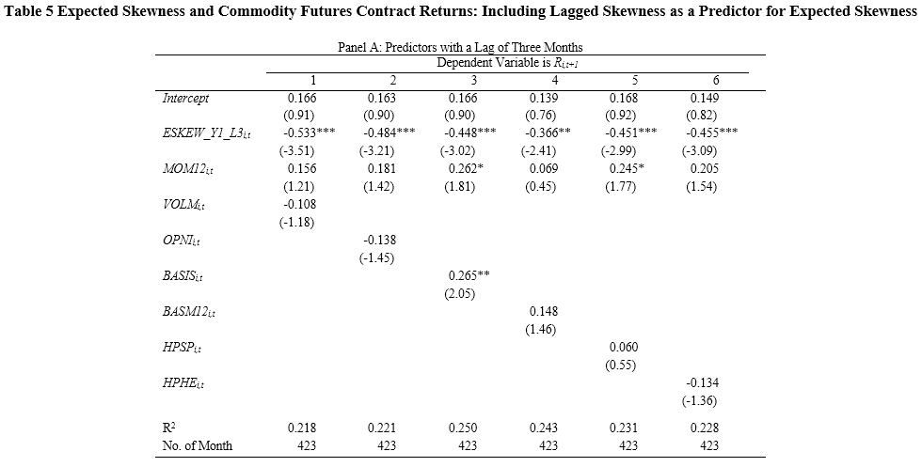
Empirical Analysis—Table 5A--3 Months
3-month lagged

Slide 36
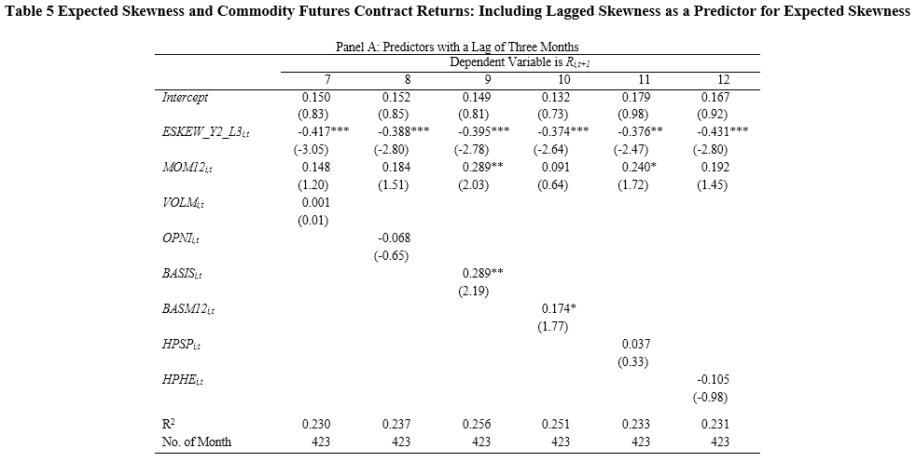
Empirical Analysis—Table 5A—3 Months
3-month lagged

Slide 37
Results from Table 5
The results of Panel B from Table 5 are similar to the results from Panel A from Table 5.
In short, all 24 models in Table 5 suggest a significant role of expected skewness in relation to futures contract monthly returns at the 5% level. Other contract characteristics are only significant occasionally depending on the model specification.

Slide 38
Table 6
The most impressive results come from Table 6, when expected skewness is constructed using only lagged values of other characteristics as predictors.
Panel A of Table 6 includes two measures of expected skewness constructed using predictors with a lag of three months: ESKEW_N1_L3_{i,t} and ESKEW_N2_L3_{i,t}.
The cross-sectional regressions add one of the following six contract characteristics at a time: VOLM_{i,t}, OPNI_{i,t}, BASIS_{i,t}, BASM12_{i,t}, HPSP_{i,t}, and HPHE_{i,t}.

Slide 39
Table 6
Panel A of Table 6 shows that four out of six estimated coefficients on ESKEW_N1_L_{i,t} are highly significant at the 5% level. The other two are significant at the 10% level. The results from Panel B of Table 6 are stronger.
In short, 22 out of 24 models in Table 6 suggest a significant role of expected skewness in relation to futures contract monthly returns at the 5% level or the 1% level. Other contract characteristics are only significant occasionally depending on the model specification.
In addition, R²s from 24 models in Table 5 and 24 models in Table 6 are close. The explanatory power of expected skewness for futures contract returns increases substantially with lagged skewness.

Slide 40
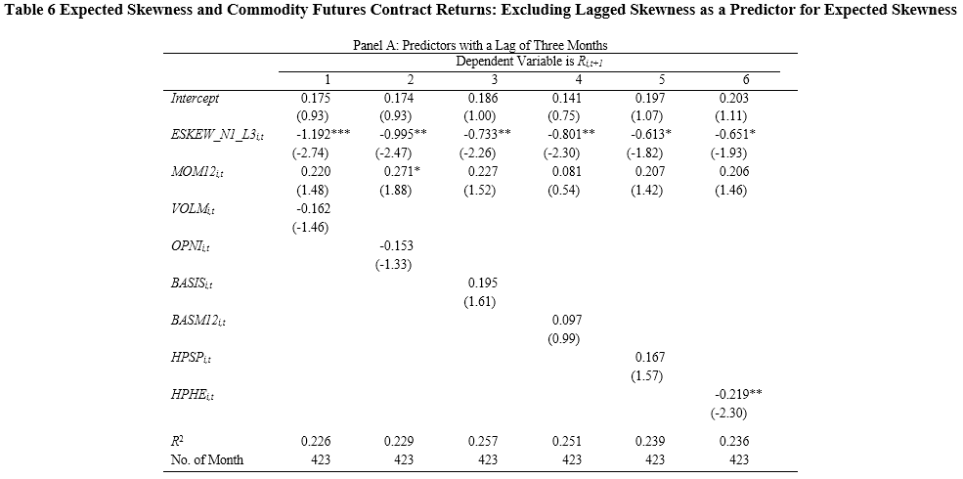
Empirical Analysis—Table 6A—3 Months
3-month lagged

Slide 41
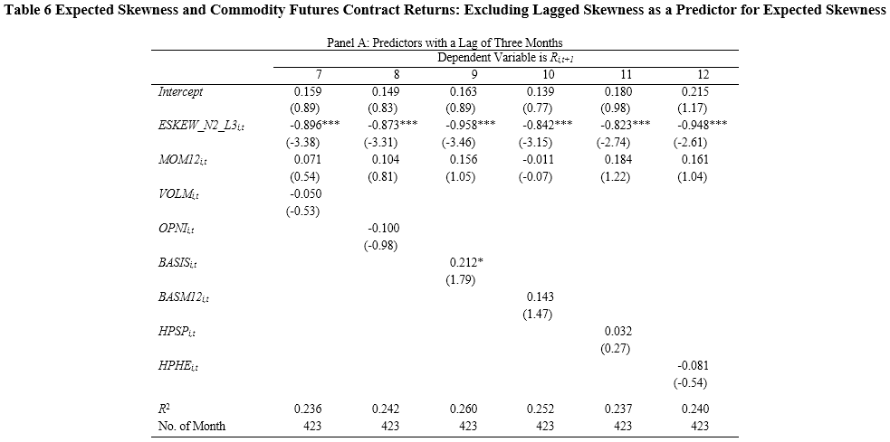
Empirical Analysis--Table 6A--3 Months
3-month lagged

Slide 42
Conclusions
The performance of skewness prediction models in the commodity futures market is much more successful than those in the U.S. equity market.
We also use a forecast combination approach to construct ex-ante measures of skewness.
Consistent with the prediction of theoretical work on skewness risk and asset returns, we find a strong negative relationship between expected skewness and commodity futures contract returns

