Slide 1
Hedging pressure and commodity option prices
Ing-Haw Cheng
Ke Tang
Lei Yan
August 2022

Slide 2
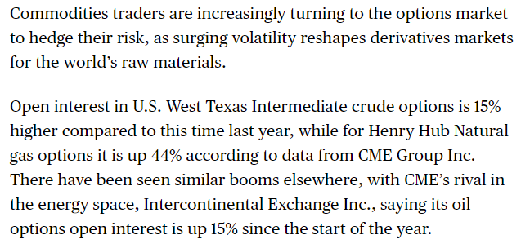
Commodity options markets
Long history of commodity options trading experiencing a resurgence
2
Notes:
Wild Commodities Run Gives Options Their Moment - Bloomberg

Slide 3
What are we doing and why
Longstanding idea: Hedging pressure / Theory of normal backwardation
Producers pay a hedging premium to hedge non-marketable risks
Theory: Limits of arbitrage
Evidence: Growing in commodity futures
New application: Does hedging pressure impact commodity options prices?
Short answer: Yes
Contribution: Propose new measure in commodity options
First (?) evidence in commodity options despite broader option evidence
Implications: Hedging strategies and speculation

Slide 4
Paper in 1 slide
Measure HPO, the net short option delta (wrt underlying futures) of commercial traders
HPO Hedgers Hedger Net Position
High (Large, positive) Large net short exposure Buy put / sell call
Low (Large, negative) Large net long exposure Sell put / buy call
Findings
1) Taking opposite (same) direction position based on HPO earns positive (negative) returns
HPO Hedger Position Strategy: Sell put / Buy call
High (Large, positive) Buy put / sell call Positive abnormal return
Low (Large, negative) Sell put / buy call Negative abnormal return
*Abnormal return = Option return delta-hedged wrt futures
2) Greatest returns earned by selling puts, consistent with limits to arbitrage
Conclusion Providing liquidity to option hedging demand earns abnormal returns
However, large profits may be difficult to capture due to limits to arbitrage
4

Slide 5
Outline
Hypotheses and HPO
Main results
Mechanisms and further analysis, robustness
5

Slide 6
HPO
Commercial traders’ net short option exposure to commodity, scaled by open interest
Weekly CFTC Commitment of Traders (COT) reports, 1995–2018 (t) for 24 markets (i)
$$\begin{aligned}{HPO}_{i, t}=\frac{{HedgersShort}_{i,t}^{option}−{HedgersLong}_{i,t}^{option}}{{OpenInterest}_{i,t}^{option}}\end{aligned}$$
Producers Seek net short exposure
Buy puts / sell calls (set a minimum selling price / reduce costs)
Processors Seek net long exposure
Buy calls / sell puts (set a maximum purchase price / reduce costs)
All else equal, positive HPO indicates producers dominate commercial traders
Balance of positions must be absorbed by speculators
6

Slide 7
HPO
HPO Hedgers Position
High (Large, positive) Net short exposure Buy put / sell call
Low (Large, negative) Net long exposure Sell put / buy call
 | Mean | SD | > 0 (%)
WTI Crude Oil | 6.34 | 4.65 | 92.5
Heating Oil | 0.79 | 11.44 | 59.3
RBOB Gasoline | 6.06 | 12.84 | 36.8
Natural Gas | 4.23 | 17.46 | 51.3
Gold | 9.30 | 7.62 | 89.4
Silver | 9.14 | 11.38 | 76.7
Copper | 3.28 | 20.68 | 59.6
Corn | -9.25 | 9.49 | 15.7
Soybeans | -1.77 | 9.90 | 40.8
Chicago Wheat | 2.10 | 12.57 | 55.9
Kansas Wheat | -12.13 | 18.25 | 23.2
Soybean Oil | -16.64 | 18.39 | 17.8
Soybean Meal | -5.83 | 16.54 | 34.4
Rough Rice | -3.89 | 31.87 | 45.7
Oats | -12.83 | 33.98 | 34.3
Coffee | -2.98 | 9.82 | 39.4
Cocoa | -9.37 | 14.39 | 23.6
Sugar | 6.72 | 14.58 | 63.4
Cotton | 10.57 | 12.64 | 79.1
Orange Juice | 1.40 | 22.60 | 52.4
Lumber | 20.66 | 20.70 | 80.2
Live Cattle | 20.88 | 13.90 | 92.6
Feeder Cattle | 5.55 | 12.10 | 65.7
Lean Hogs | 18.85 | 13.95 | 88.7
Average | 2.13 | 15.49 | 54.9
7

Slide 8
Hypothesis
Option strategies that provide liquidity to hedging demand should earn abnormal returns
Strategy: Sell put, Buy call (net long exposure)
Provides liquidity to hedging demand when HPO is high and hedgers are short
Trades in same direction as hedging demand when HPO is low and hedgers are long
HPO Hedger Position Strategy: Sell put / Buy call
High (Large, positive) Buy put/sell call Positive abnormal return
Low (Large, negative) Sell put/buy call Negative abnormal return
Prediction: HPO should positively forecast returns to (Sell put, Buy call) strategy
Use the cross section of commodities to test for return spreads and levels
8

Slide 9
Outline
Hypotheses and HPO
Main results
Hedging pressure forecasts the returns to option strategies that provide liquidity
Correlated with and predicts future changes in IV slopes
Mechanisms and further analysis, robustness
9

Slide 10
Returns
In every commodity market (i) and every week (t), for horizons of k=1,2,3,4 weeks:*
Calculate delta-hedged returns to every option (with different maturities T)
“Abnormal option price” relative to Black-Scholes
Calculate portfolio returns for OTM options (0.125 < |Delta| < 0.375): ${\overline{Ret}}_{i,t+k}^{OTM}$
OTM options tend to be more liquid
Calculate “long-short” returns to buying portfolio of OTM calls and selling OTM puts:
$$\begin{aligned}{Ret}_{i,t+k}^{long−short}={\overline{Ret}}_{i,t+k}^{OTM Call}−{\overline{Ret}}_{i,t+k}^{OTM Put}\end{aligned}$$
$1 long call, $1 short put. Ignores margin & transaction costs.
* Details in the paper.
10

Slide 11
HPO vs Average Returns
11

Slide 12
Portfolio sorts
Rank 24 commodities by HPO on Tuesday of each week
Equal-weight ${Ret}_{i,t+k}^{long−short}$ across commodities where weeks occur Tuesday-Tuesday
 | ${HPO}_{t}$ (%) | Delta-hedged return of the long-short strategy from $t$ to $t+k$ (%)
 |  | k = 1 | k = 2 | k = 3 | k = 4
Portfolio 1 | -23.41 | -1.84*** | -2.99*** | -4.29*** | -5.60***
 |  | (-5.91) | (-5.66) | (-5.77) | (-5.88)
Portfolio 2 | -5.72 | -1.21*** | -2.42*** | -3.59*** | -4.43***
 |  | (-4.38) | (-5.04) | (-5.34) | (-5.16)
Portfolio 3 | 2.95 | -0.37 | -1.09** | -1.84*** | -2.50***
 |  | (-1.14) | (-2.14) | (-2.69) | (-2.99)
Portfolio 4 | 10.09 | 0.09 | -0.27 | -0.45 | -1.10
 |  | (0.32) | (-0.55) | (-0.69) | (-1.40)
Portfolio 5 | 22.98 | 0.72*** | 1.20*** | 1.35** | 0.80
 |  | (2.69) | (2.82) | (2.29) | (1.05)
Portfolio 5 – Portfolio 1 |  | 2.56*** | 4.19*** | 5.64*** | 6.41***
 |  | (6.25) | (6.18) | (6.09) | (5.78)
Summary statistics of weekly returns to Portfolio 5-minutes-Portfolio 1
SD (%) |  | 14.37 | 19.32 | 23.06 | 25.68
Sharpe Ratio (Mean/SD) |  | 0.18 | 0.22 | 0.24 | 0.25
Skewness |  | 0.41 | 0.31 | 0.17 | 0.11
Median (%) |  | 2.49 | 3.31 | 4.80 | 5.78
12

Slide 13
Fama-MacBeth
$$\begin{aligned}{Ret}_{i,t+k}^{long−short}=α_{0}+α_{1}{HPO}_{i,t}+α_{2}{MFV}_{i,t}+α_{3}{TTM}_{i,t}+α_{4}{CY}_{i,t}+α_{5}{Ret}_{i,t}^{long−short}+ε_{i,t+k} \\ \end{aligned}$$
A 1-stdev increase in HPO predicts 60 (144) basis points of return for one (four) weeks
 | Dependent variable: ${Ret}_{i,t+k}^{long−short}$
 | k = 1 | k = 2 | k = 3 | k = 4 | k = 1 | k = 2 | k = 3 | k = 4
 | (1) | (2) | (3) | (4) | (5) | (6) | (7) | (8)
$${HPO}_{i,t}$$ | 4.39*** | 8.79*** | 12.15*** | 12.51*** | 4.00*** | 7.99*** | 7.83*** | 9.61***
 | (5.42) | (6.87) | (6.87) | (4.06) | (4.46) | (5.66) | (3.31) | (2.76)
$${MFV}_{i,t}$$ |  |  |  |  | -5.47*** | -11.76*** | -12.36*** | -16.46***
 |  |  |  |  | (-3.01) | (-3.60) | (-3.08) | (-3.10)
$${TTM}_{i,t}$$ |  |  |  |  | 0.02 | 1.08 | 26.16 | 20.16**
 |  |  |  |  | (0.01) | (0.09) | (1.25) | (2.18)
$${CY}_{i,t}$$ |  |  |  |  | -0.36 | 0.03 | 0.75 | -1.25
 |  |  |  |  | (-0.42) | (0.02) | (0.39) | (-0.57)
$${Ret}_{i,t}^{long−short}$$ |  |  |  |  | -0.05*** | 0.00 | 0.02 | 0.00
 |  |  |  |  | (-4.60) | (0.03) | (1.32) | (0.22)
$$Intercept$$ | -0.64*** | -1.37*** | -2.08*** | -2.60*** | 0.85 | 1.19 | -1.85 | -1.21
 | (-3.60) | (-4.60) | (-5.20) | (-3.51) | (1.20) | (0.81) | (-0.84) | (-0.56)
$$Adj. R^{2}$$ | 0.01 | 0.01 | 0.01 | 0.01 | 0.08 | 0.07 | 0.07 | 0.06
$$Obs (weeks)$$ | 1236 | 1235 | 1234 | 1233 | 1235 | 1233 | 1231 | 1229
13

Slide 14
Alternative perspective: Implied volatility slopes
IV Slope (scaled by ATM IV): ${slope}_{i,t}^{T}=\frac{{IV}_{i,t}^{OTM Call^{T}}−{IV}_{i,t}^{OTM Put^{T}}}{{IV}_{i,t}^{ATM option^{T}}}$
HPO Hedger Position IV Slope
Positive Buy put/sell call Negative: IV_{OTM puts} > IV_{OTM calls}
Negative Sell put/buy call Positive: IV_{OTM calls} > IV_{OTM puts}
Prediction: Positive HPO should indicate lower / negative IV slope
Positive HPO should predict subsequent increase in IV slope
14

Slide 15
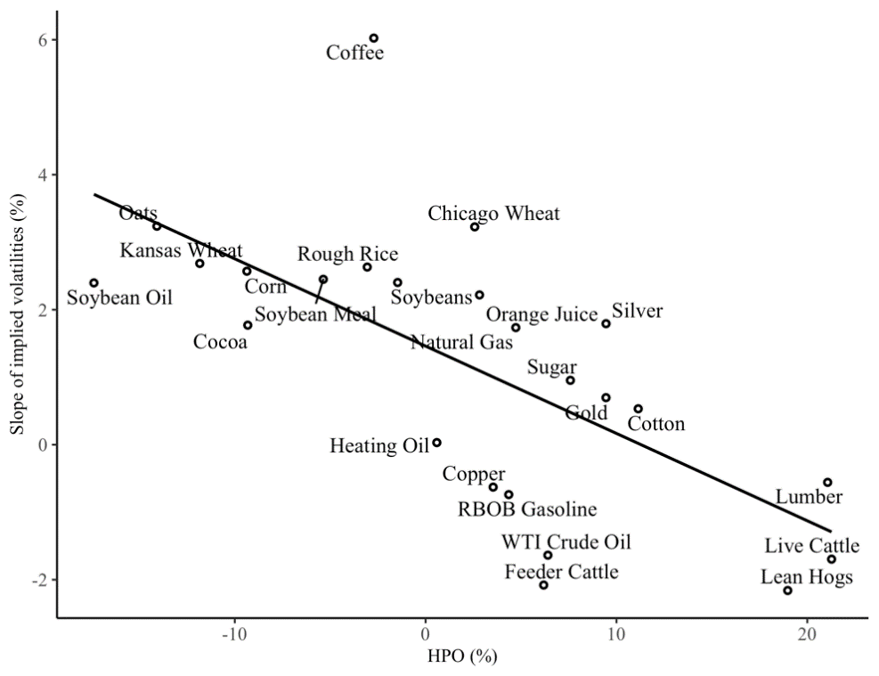
Alternative perspective: Implied volatility slopes
(a) HPO vs. slope of implied volatility smile
(b) HPO vs. 1-week change in slope of implied volatility smile
15

Slide 16
Outline
Hypotheses and HPO
Main results
Hedging pressure forecasts the returns to option strategies that provide liquidity
Correlated with and predicts future changes in IV slopes
Mechanisms and further analysis, robustness
16

Slide 17
Mechanisms and further analysis
Measure returns Monday-to-Monday (allowing for timing of COT report release)
Hedging pressure predictability not driven by price pressure
Predictability of hedging pressure for returns is driven by position levels, not changes
HPO is incrementally informative for options returns over futures hedging pressure (HPF)
Hedgers trade options in the same direction as futures
But a lot of unexplained variation in unconditional correlations
Fundamental factors tend to have similar effects on HPO and HPF
Greatest returns to providing liquidity is driven by selling puts
Consistent with margin requirements as significant limits to arbitrage
Santa-Clara and Saretto (2008)

Slide 18
Hedging pressure by option type
$${\overline{Ret}}_{i,t+k}^{OTM Call} or −{\overline{Ret}}_{i,t+k}^{OTM Put}=α_{0}+α_{1}{HPO}_{i,t}+Controls+ε_{i,t+k}$$
 | k = 1 | k = 2 | k = 3 | k = 4
Dependent variable: ${\overline{Ret}}_{i,t+k}^{OTM Call}$
$${HPO}_{i,t}$$ | 0.17 | 1.79 | 1.58 | 2.72
 | (0.16) | (0.91) | (0.70) | (1.01)
$$Intercept$$ | -3.53*** | -7.71*** | -12.83*** | -13.41***
 | (-3.38) | (-4.35) | (-5.70) | (-4.63)
Controls | Yes | Yes | Yes | Yes
$$Adj. R^{2}$$ | 0.08 | 0.08 | 0.08 | 0.07
$$Obs (weeks)$$ | 1235 | 1233 | 1231 | 1229
Dependent variable: $−{\overline{Ret}}_{i,t+k}^{OTM Put}$
$${HPO}_{i,t}$$ | 3.83*** | 6.20*** | 6.25*** | 6.89*
 | (3.82) | (3.38) | (2.36) | (1.93)
$$Intercept$$ | 4.38*** | 8.90*** | 10.98*** | 12.20***
 | (5.17) | (5.55) | (3.86) | (3.93)
Controls | Yes | Yes | Yes | Yes
$$Adj. R^{2}$$ | 0.06 | 0.07 | 0.07 | 0.06
$Obs (weeks)$ | 1235 | 1233 | 1231 | 1229
18

Slide 19
Robustness: Subsamples

Slide 20
Summary
This paper Provide a new, simple measure of hedging pressure in options markets
Conclusions Providing liquidity to option hedging demand earns abnormal returns
However, large profits may be difficult to capture due to limits to arbitrage
Implications Speculation / Liquidity provision
HPO a useful real-time indicator for traders with few margin constraints and tolerance for absorbing volatility of the trade
Hedging strategies
Options vs futures: Each incur different premiums
Trade-offs in hedging strategies
20

