Slide 1
Measuring Financial Investor Presence Through Term Structure Deflection
Discussion:
Ing-Haw Cheng
Univ of Toronto
Paper:
Zeno Adams Univ of St Gallen
Solène Collet Univ of St Gallen
Andrei Kirilenko Univ of Cambridge

Slide 2
Outline
How can we detect any price effects of commodity index investing?
Nice paper & simple idea
Comments

Slide 3
Commodity index investing
Question: Does commodity index investing have price effects?
Nuanced issue beyond “Do index investors cause a bubble?” (Cheng & Xiong, 2014)
Time-varying correlations and hedging premiums
Price impact of roll
Leverage rebalancing
Empirical problem: Well-documented noisy measurement of index positions

Slide 4
This paper
Use term structure “deflection” to measure the price impact of index investors
Exploit the fact that maintaining continuous exposure to commodities through futures requires rolling out of the first, and into the second, contract
Process
Fit a cubic spline across the term structure omitting first, second contracts
Deflection = Net deviation of traded prices from predicted (+ implies “too steep”)

Slide 5
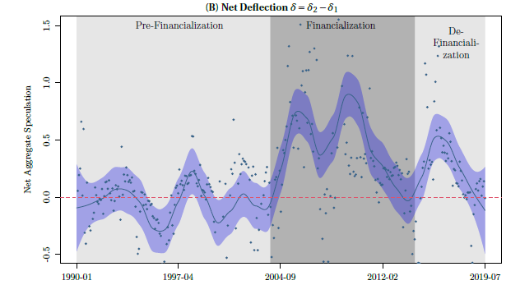
Key findings
Deflections are unusually high during peak growth of investor investing
2) Deflections are positively correlated with crude oil volatility

Slide 6
Nice paper
Question Does commodity index investing have price effects?
Answer Yes, measured through term structure deflection
Discussion
Overall Straightforward idea that creates a useful measure
Potential for others to use and cite this measure
Main comment Two questions about what the measure captures + 3 suggestions
Minor comments
Notes:
Overall arc of discussion : Provide some specific suggestions but also pose a number of questions for the author to make the paper ultimately “bigger”

Slide 7
Conceptual issue at core of paper
Limits to arbitrage
Index trading creates price pressure during the roll due to limited arbitrage capital
Plenty of arbitrage capital should smooth the curve and keep deflections close to zero
Related issue: Index investors should absorb hedging demand and reduce hedging premiums
Less relevant for this paper
Deflection represents the price effect of commodity index investing if:
Deflections represent potential mispricing
Deflections are primarily driven by index investing

Slide 8
1.) Do deflections represent potential mispricing?
Trading desks should be willing to make relative value trade if futures are mispriced
Cash and carry (Futures hedged with spot)
Calendar spread (F₁ hedged with F₂)
In equilibrium, there is some money left on the table due to limits of arbitrage
Paper: Selling pressure pushes down F₁, buying pressure raises F₂
Front-run by selling F₁ and buying F₂ in advance of the roll and unwind during the roll
Back-run by buying F₁ and selling F₂ during the roll and unwinding after
Neither are a riskless arbitrage due to basis risk

Slide 9
1.) Do deflections represent potential mispricing?
Source: Mou (2011)
Suggestion 1 Update and use deflection as a more sophisticated trading signal
Zoom in on timing of deflection before, during, and after roll

Slide 10
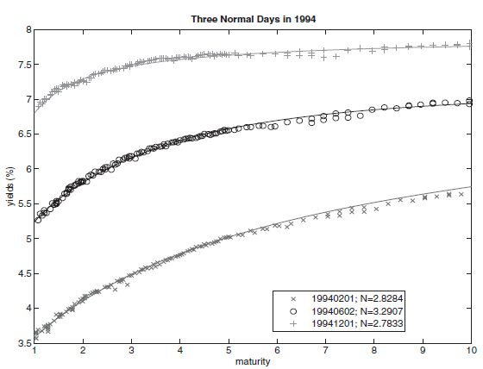
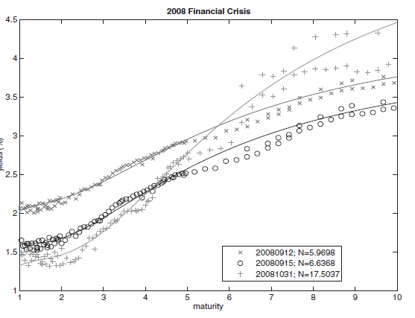
2.) How much are deflections related to index investing?
Periods of high deflections may also be driven by:
Alternative 1: Low supply of arbitrage capital (vs demand of indexers)
Unusually low limited arbitrage capital may be correlated with oil price volatility
“Noisy” Treasury curve reflects shortage of arbitrage capital of overall markets
Source: Hu, Pan, and Wang (2013)

Slide 11
2.) How much are deflections related to index investing?
Suggestion 2 Calculate “noise” or deflections across the entire futures curve
Focus on deflection on F₁ and F₂ conditional on total noise
Source: Hu, Pan, and Wang (2013)

Slide 12
2.) How much are deflections related to index investing?
Deflections may also be influenced by:
Alternative 2: Storage/convenience yield dynamics
Deflections are large errors in the front-end relative to a cubic spline
Such errors may reflect unusually steep term structure of net convenience yield
Such errors may be correlated with volatility since the front-end of the curve is volatility is concentrated on the front-end of the curve
Paper does a good job identifying most extreme events, but more needs to be done
Suggestion 3 Focus on noise in front part of curve during the roll period

Slide 13
Minor comments
Why does greater deflection lower volatility pre-financialization?
Expect pre-financialization relationship to be zero under the assumption that index investors drive deflection, since pre-fin deflection should then be white noise
Other questions
Why just oil?
Why oil volatility? Clarify mechanism of hypothesized relationship

Slide 14
Nice paper
Question Does commodity index investing have price effects?
Answer Yes, measured through term structure deflection
Discussion
Overall Straightforward idea that creates a useful measure
Potential for others to use and cite this measure
Main comment Two questions about what the measure captures + 3 suggestions
Minor comments
Notes:
Overall arc of discussion : Provide some specific suggestions but also pose a number of questions for the author to make the paper ultimately “bigger”

