Slide 1
Relative Basis and Risk Premia in Commodity Futures Markets
Ming Gu
Xiamen University
Wenjin Kang
Shanghai University of Finance and Economics
Shanghai Institute of International Finance and Economics
Dong Lou
London School of Economics and Political Sciences and CEPR
Ke Tang
Tsinghua University

Slide 2
Motivation: Theory of Storage
Theory of Storage: A long-standing and important theory for the commodity futures markets.
  It can be traced back to as early as Kaldor (1939), Working (1949), and Brenann (1958), and are then followed by a large number of studies, such as Fama and French (1988), Hirshleifer (1990), Ng and Pirrong (1994), Carbonez, Nguyen, and Sercu (2009), Gorton, Hayashi, and Rouwenhorst (2013).
In the Theory of Storage, we compare between the benefits of holding spot commodities or futures contracts
  There is an implicit but important benefit, dubbed the “convenience yield”, that accrues to the owners of the physical commodity, but not to the owners of the commodity futures contracts.
Notes:
Theory of Storage compares the benefit of holding futures or spot commodities.
Convenience yield便利收益 has a negative relationship with inventory.
Lower levels of inventory correspond to higher risk premiums.

Slide 3
Motivation: Theory of Storage
Convenience yield is closely related to inventory.
  Convenience yield increases when inventory decreases.
  When the inventory is particularly low, it may have “stock-out” risk, as suggested by Deaton and Laroque (1992) and Routledge, Seppi, and Spatt (2000), and therefore extra convenience yield.
Convenience yield also predicts commodity futures returns.
  No consensus on why this is the case
  One possibility is convenience yield’s close relation to inventory

Slide 4
Motivation: Theory of Storage
The literature uses the basis (the slope of futures term structure) as a proxy of the convenience yield.
  We call it the “traditional basis”
The (traditional) basis is a noisy measure of convenience yield, because it is determined not only by convenience yield, but also other commodity-specific characteristics.
  Most notably the cost to carry the commodity, which includes both the physical storage cost and financing cost.
  Financing costs may vary because some commodities (e.g., gold) can be more readily used as collaterals for borrowing than other commodities (e.g., soybeans).

Slide 5
Motivation: Theory of Storage
The traditional basis (TradtBasis) measure has the following empirical features:
  The traditional basis is persistent over the time, yet inventory shocks are temporary
  In a simple univariate regression setting, the traditional basis predicts next-month futures returns. However, its return prediction power diminishes when adding other commodity risk characteristics.
  The traditional basis measure has strong return predictability for financial futures, unlikely to be related to convenience yield

Slide 6
Our Relative Basis Measure
We introduce a new Relative basis (RelatBasis) measure, which is defined as the difference between the short-term basis (based on the first- and second-nearby futures contracts) and a similarly defined long-term basis (based on the second- and third-nearby futures contracts).
  It reflects the curvature of the futures term structure.
  Relative basis has more time-series variation and also has a strong positive relationship with the scarcity of inventory.
Relative basis outperforms the traditional basis in return predictability.
  It subsumes the traditional basis measure in both the Fama-MacBeth regression and factor portfolio return test.
  It does not predict financial futures returns, as suggested by the Theory of Storage.

Slide 7
Data and Methodology
We obtain monthly data on futures prices from the Commodity Systems Inc. (CSI) for commodities traded on NYMEX, CBOT, and CME.
  Our sample covers 24 commodities from Jan 1979 to Dec 2019.
We obtain position information for different participants in commodity futures markets by using the Commitment of Trader (COT) data provided by the commodity futures trading commission (CFTC).
We also follow Gorton, Hayashi, and Rouwenhorst (2013) and collect inventory data from a variety of sources, for a limited sample period though.

Slide 8
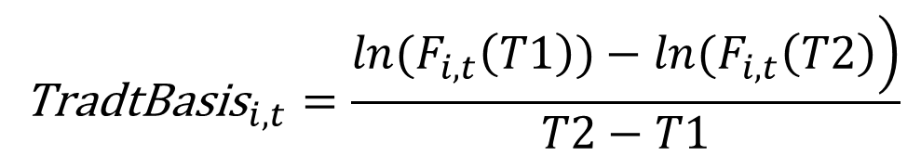
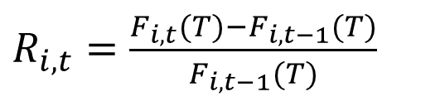
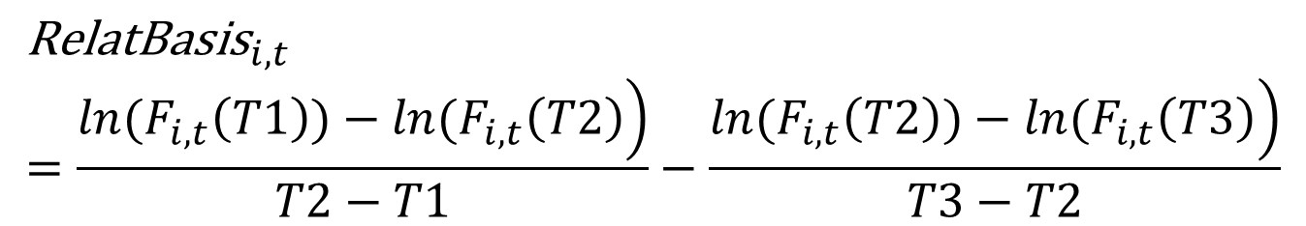
Data and Methodology
Futures excess return
Traditional Basis
Relative Basis
$R_{i,t}=\frac{F_{i,t}(T)−F_{i,t−1}(T)}{F_{i,t−1}(T)}$
$${\text{TradtBasis}}_{i,t}=\frac{\left.ln(F_{i,t}\left(T1\right))−ln(F_{i,t}\left(T2\right)\right)}{T2−T1}$$
$${\text{RelatBasis}}_{i,t}=\frac{\left.ln(F_{i,t}\left(T1\right))−ln(F_{i,t}\left(T2\right)\right)}{T2−T1}−\frac{\left.ln(F_{i,t}\left(T2\right))−ln(F_{i,t}\left(T3\right)\right)}{T3−T2}$$

Slide 9
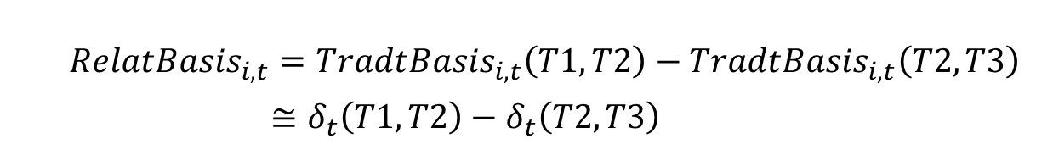
Our Relative Basis Measure
$$\left.F_{i,t}\left(T\right)=S_{i,t}exp{[}r_{t}^{f}(t,T)×\left(T−t\right)−δ_{i,t}\left(t,T\right)×\left(T−t\right)+w_{i,t}\left(t,T2\right)×\left(T−t\right)\right]$$
${\text{TradtBasis}}_{i,t}\left(T1,T2\right)=δ_{i,t}\left(T1,T2\right)−r_{t}^{f}\left(T1,T2\right)−w_{i,t}\left(T1,T2\right)$
$${\text{TradtBasis}}_{i,t}\left(T2,T3\right)=δ_{i,t}\left(T2,T3\right)−r_{t}^{f}\left(T2,T3\right)−w_{i,t}\left(T2,T3\right)$$
${RelatBasis}_{i,t}={TradtBasis}_{i,t}\left(T1,T2\right)−{TradtBasis}_{i,t}\left(T2,T3\right)$
$≅δ_{t}\left(T1,T2\right)−δ_{t}\left(T2,T3\right)$
Notes:
where is the spot price for commodity i at time t, is the risk free rate from t to , is the convenience yield for commodity i from t to , and is the percentage storage cost (i.e., storage cost divided by spot prices) for commodity i from t to .

Slide 10
Data and Methodology
We then run a cross-sectional regression of the Traditional Basis measure on the Relative Basis measure, with the intercept plus the residual item named as the Residual Basis (ResidBasis).
  Traditional Basis = Relative Basis + Residual Basis
  The relative basis and the residual basis are orthogonal to each other.
 | RelatBasis | TradtBasis | ResidBasis | Momentum | BasisMom
RelatBasis | 1.00 | 0.52 | 0.00 | 0.04 | 0.20
TradtBasis |  | 1.00 | 0.76 | 0.39 | 0.36
ResidBasis |  |  | 1.00 | 0.44 | 0.29
Momentum |  |  |  | 1.00 | 0.36
BasisMom |  |  |  |  | 1.00

Slide 11
Data and Methodology
We present the time-series autocorrelation structure for the Traditional Basis, the Relative Basis, and the Residual Basis measures as below.
 | TradtBasis | RelatBasis | ResidBasis
Lag 1 month | 0.34 | 0.68 | 0.71
Lag 2 month | 0.08 | 0.51 | 0.56
Lag 3 month | -0.02 | 0.40 | 0.45
Lag 4 month | -0.03 | 0.34 | 0.38
Lag 5 month | -0.03 | 0.31 | 0.34
Lag 6 month | 0.00 | 0.30 | 0.31

Slide 12
Futures Return Predictability
We examine which basis measure can better predict futures return on commodity markets, the Relative Basis, the Traditional Basis, or the Residual Basis
  Our sample of commodities includes the following categories: Energy, Metals, Soft, Agriculture, and Live Stocks.
As a comparison, we also conduct the same return-prediction regression on the financial futures markets.
  We includes 19 financial futures that include stock index futures, interest rate futures, and forex futures.
  Remember that there is no inventory concern for financial futures.

Slide 13
Futures Return Predictability
Return Predictability of Relative Basis on Commodity Futures Markets: Fama-MacBeth Regressions
 | (1) | (2) | (3) | (4) | (5) | (6) | (7) | (8)
RelatBasis_{i,t} | 0.019 |  |  | 0.018 |  |  | 0.017 | 0.024
 | (3.44) |  |  | (2.65) |  |  | (2.53) | (2.85)
ResidBasis_{i,t} |  | 0.010 |  |  | -0.008 |  | -0.011
 |  | (1.43) |  |  | (-1.06) |  | (-1.44)
TradtBasis_{i,t} |  |  | 0.011 |  |  | -0.002 |  | -0.011
 |  |  | (2.16) |  |  | (-0.30) |  | (-1.44)
Momentum_{i,t} |  |  |  | 0.013 | 0.012 | 0.012 | 0.016 | 0.016
 |  |  |  | (2.68) | (2.19) | (2.25) | (2.95) | (2.95)
BasisMom_{i,t} |  |  |  | 0.035 | 0.050 | 0.048 | 0.042 | 0.042
 |  |  |  | (1.87) | (2.54) | (2.54) | (2.05) | (2.05)
Adj R² | 2.3% | 3.2% | 3.3% | 9.7% | 10.7% | 10.4% | 12.7% | 12.7%

Slide 14
Futures Return Predictability
Return Predictability of Relative Basis on Financial Futures Markets: Fama-MacBeth Regressions
 | (1) | (2) | (3) | (4) | (5) | (6) | (7) | (8)
RelatBasis_{i,t} | 0.013 |  |  | 0.067 |  |  | 0.099 | 0.013
 | (0.11) |  |  | (0.65) |  |  | (1.00) | (0.12)
ResidBasis_{i,t} |  | 0.120 |  |  | 0.082 |  | 0.083
 |  | (4.55) |  |  | (2.78) |  | (2.92)
TradtBasis_{i,t} |  |  | 0.100 |  |  | 0.078 |  | 0.083
 |  |  | (3.41) |  |  | (2.60) |  | (2.92)
Momentum_{i,t} |  |  |  | 0.030 | 0.024 | 0.023 | 0.027 | 0.027
 |  |  |  | (3.85) | (2.50) | (2.48) | (3.11) | (3.11)
BasisMom_{i,t} |  |  |  | 0.667 | 0.433 | 0.367 | 0.466 | 0.466
 |  |  |  | (2.40) | (1.96) | (1.52) | (1.78) | (1.78)
Adj R² | 2.1% | 3.8% | 4.0% | 23.0% | 27.1% | 28.4% | 27.8% | 27.8%

Slide 15
Futures Return Predictability
To sum up, for commodity futures, the relative basis subsumes the traditional basis
  Assume that the relative basis increases from the average minus one standard deviation to plus one standard deviation for commodity futures, its return impact will be 2*17.3%*0.018 = 0.62% per month, or 7.5% in annualized rates.
For financial futures, there is no significant return predictability based on the relative basis. It is the residual basis that determines next-month futures returns
  Assume that the relative basis increases from the average minus one standard deviation to plus one standard deviation for financial futures, its return impact will be at most 2*0.88%*0.067 = 0.12% per month.

Slide 16
Positive vs. Negative RelatBasis
Return Predictability of Positive and Negative Relative Basis on Commodity Futures Markets: Fama-MacBeth Regressions
 | (1) | (2) | (3) | (4)
RelatBasis_pos_{i,t} | 0.045 | 0.047 | 0.048 | 0.060
 | (2.87) | (2.63) | (2.68) | (3.47)
RelatBasis_neg_{i,t} | 0.016 | 0.007 | 0.006 | 0.019
 | (1.17) | (0.49) | (0.45) | (1.21)
ResidBasis_{i,t} |  |  | -0.012
 |  |  | (-1.42)
TradtBasis_{i,t} |  |  |  | -0.012
 |  |  |  | (-1.42)
Momentum_{i,t} |  | 0.012 | 0.016 | 0.016
 |  | (2.61) | (2.98) | (2.98)
BasisMom_{i,t} |  | 0.039 | 0.046 | 0.046
 |  | (1.93) | (2.22) | (2.22)
Adj R² | 4.3% | 11.8% | 14.5% | 14.5%

Slide 17
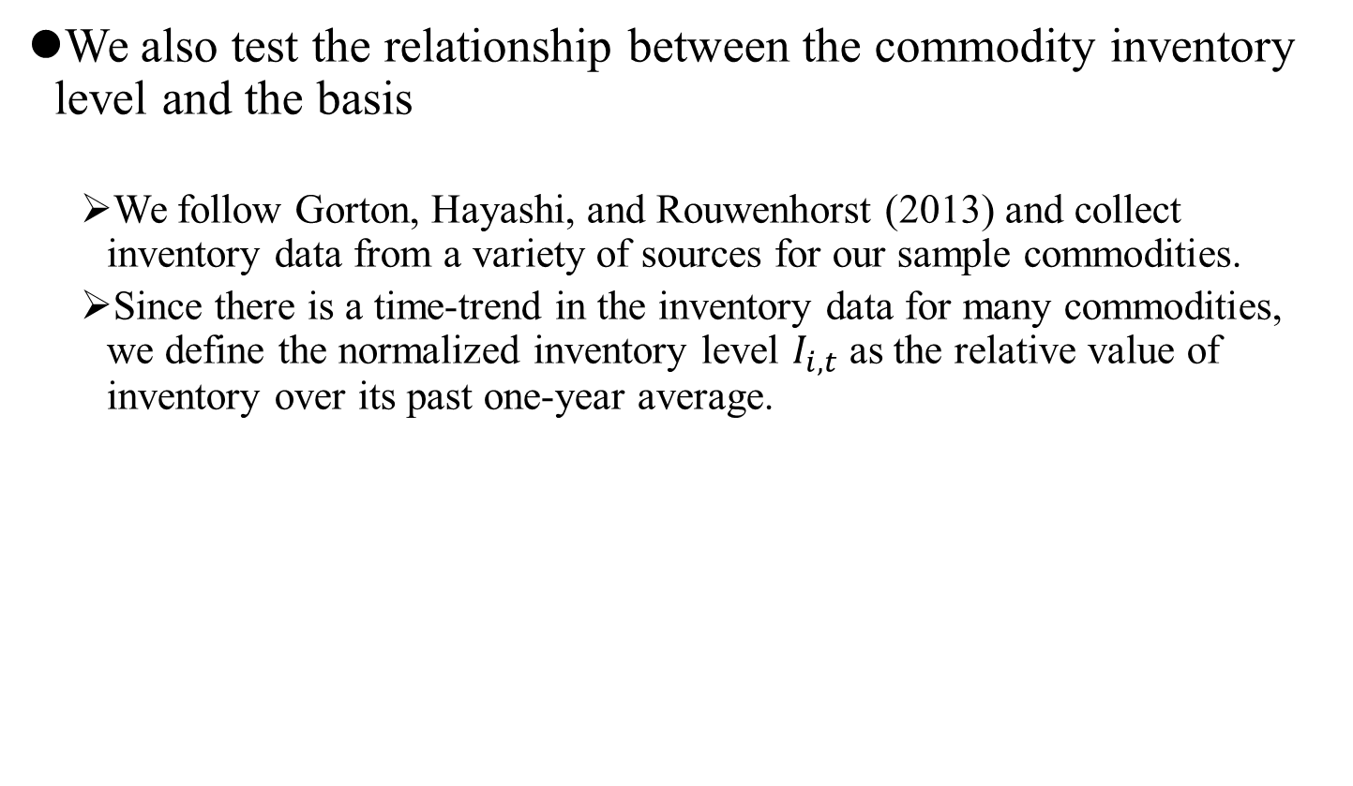
Inventory and Relative Basis
We also test the relationship between the commodity inventory level and the basis
  We follow Gorton, Hayashi, and Rouwenhorst (2013) and collect inventory data from a variety of sources for our sample commodities.
  Since there is a time-trend in the inventory data for many commodities, we define the normalized inventory level $I_{i,t}$ as the relative value of inventory over its past one-year average.
 | RelatBasis_{i,t} | ResidBasis_{i,t} | TradtBasis_{i,t}
Inventory_{i,t} | 0.028 | -0.070 | -0.074
 | (1.17) | (-3.01) | (-2.40)
1/Inventory_{i,t} | 0.095 | 0.001 | 0.056
 | (3.92) | (0.03) | (1.83)
Adj R² | 0.2% | 0.2% | 0.9%

Slide 18
Robustness Tests
We conduct additional robustness tests.
      Observe a stronger futures return prediction in the next quarter.
    Re-do the futures return prediction using panel regressions
  Re-do the futures return prediction regression in two sub-periods, 1979-1999 and 2000-2019.
  Re-do the futures return prediction regression in an alternative sample, where we adjust the maturities of the first, second, and third nearby contract of energy commodities crude oil , so that relative basis employs the same horizon for all commodities.

Slide 19
Portfolio Sorting Analysis
We also conduct portfolio sorting analysis based on these three basis measures.
  At the end of each month, we construct three equally-weighted commodity futures portfolios based on the relative basis.
  We then observe these three portfolio returns, as well as the return difference between the portfolios with the highest and lowest relative basis measure, in the post one month and one quarter horizon.
Again, as a “control group” test, we repeat the portfolio sorting analysis above on financial futures markets.

Slide 20
Portfolio Sorting Analysis
Portfolio Sorting Based on Different Basis Measures on Commodity Futures Markets
 | P1 | P2 | P3 | P3-P1
 | mean | mean | mean | mean | t-stat
Sorted by RelatBasis
next month | -0.22% | -0.10% | 0.59% | 0.81% | (3.99)
next quarter | -0.89% | -0.19% | 1.82% | 2.71% | (6.64)
Sorted by TradtBasis
next month | -0.22% | -0.06% | 0.54% | 0.75% | (3.30)
next quarter | -1.03% | -0.11% | 1.86% | 2.89% | (5.07)
Sorted by ResidBasis
next month | -0.24% | 0.08% | 0.41% | 0.65% | (2.97)
next quarter | -0.66% | -0.07% | 1.46% | 2.12% | (3.60)

Slide 21
Portfolio Sorting Analysis
Portfolio Sorting Based on Different Basis Measures on Financial Futures Markets
 | P1 | P2 | P3 | P3-P1
 | mean | mean | mean | mean | t-stat
Sorted by RelatBasis
next month | 0.17% | 0.10% | 0.24% | 0.07% | (0.55)
next quarter | 0.51% | 0.32% | 0.68% | 0.17% | (0.63)
Sorted by TradtBasis
next month | -0.06% | 0.19% | 0.38% | 0.44% | (3.11)
next quarter | -0.26% | 0.58% | 1.16% | 1.42% | (3.78)
Sorted by ResidBasis
next month | -0.11% | 0.18% | 0.40% | 0.51% | (4.70)
next quarter | -0.29% | 0.59% | 1.12% | 1.41% | (4.64)

Slide 22
Portfolio Spanning Test
Risk-adjusted Returns of the Relative Strategy Portfolio Based on RelatBasis on Commodity Futures Markets
 | RelatBasisRet | RelatBasisRet | RelatBasisRet
Intercept | 0.685 | 0.686 | 0.633
 | (3.48) | (3.48) | (3.35)
ResidBasisRet
TradtBasisRet |  | -0.012
 |  | (-0.25)
MKTRet |  |  | 0.303
 |  |  | (6.74)
MomRet | 0.099 | 0.099 | 0.104
 | (1.74) | (1.73) | (1.92)
BasisMomRet | -0.090 | -0.086 | -0.179
 | (-2.40) | (-2.02) | (-4.66)
Adj.R² | 0.196 | 0.200 | 0.091

Slide 23
Portfolio Spanning Test
Risk-adjusted Returns of the Relative Strategy Portfolio Based on TradtBasis and ResidBasis on Commodity Futures Markets
 | ResidBasisRet | ResidBasisRet | TradtBasisRet | TradtBasisRet
Intercept | 0.056 | 0.063 | 0.172 | -0.021
 | (0.31) | (0.35) | (0.90) | (-0.12)
RelatBasisRet |  | -0.010 |  | 0.282
 |  | (-0.25) |  | (6.74)
MKTRet | -0.031 | -0.030 | -0.017 | -0.045
 | (-0.59 | (-0.57) | (-0.32) | (-0.86)
MomRet | 0.388 | 0.387 | 0.294 | 0.319
 | (11.25) | (11.15) | (8.07) | (9.10)
BasisMomRet | 0.279 | 0.282 | 0.346 | 0.290
 | (7.08) | (6.98) | (8.28) | (7.12)
Adj.R² | 29.0% | 29.0% | 23.8% | 30.2%

Slide 24
Strategy Portfolios Returns among Different Business Cycles
Portfolio sorting based on relative basis
 |  | P1 | P3 | P3-P1
contraction | next month | -0.21% | 0.31% | 0.51%
 |  |  |  | (1.86)
 | next quarter | -0.74% | 0.99% | 1.73%
 |  |  |  | (3.45)
expansion | next month | -0.23% | 0.89% | 1.12%
 |  |  |  | (4.03)
 | next quarter | -1.04% | 2.64% | 3.69%
 |  |  |  | (7.78)
Expansion - contraction | next month |  |  | 0.61%
 |  |  |  | (1.55)
 | next quarter |  |  | 1.96%
 |  |  |  | (2.84)

Slide 25
Strategy Portfolios Returns among Different Business Cycles
Strategy portfolios returns based on relative basis
 | RelatBasisRet_{t} |  |  | RelatBasisRet_{q}
 | contraction | expansion |  | contraction | expansion
Intercept | 0.369 | 0.958 | Intercept | 1.046 | 3.217
 | (1.38) | (3.35) |  | (1.96) | (6.32)
MKTRet_{t} | 0.085 | 0.125 | MKTRet_{q} | 0.188 | 0.084
 | (1.22) | (1.31) |  | (2.68) | (0.92)
MomRet_{t} | -0.189 | 0.020 | MomRet_{q} | -0.028 | 0.017
 | (-3.82) | (0.36) |  | (-0.54) | (0.30)
BasisMomRet_{t} | 0.297 | 0.121 | BasisMomRet_{q} | 0.237 | 0.146
 | (4.85) | (2.01) |  | (3.44) | (2.45)
obs | 11.0% | 2.3% | obs | 6.6% | 2.9%
Adj R² | 0.369 | 0.958 | Adj R² | 1.046 | 3.217

Slide 26
Conclusions
We propose a new basis measure, the Relative Basis.
  The relative basis can be viewed as the fast-moving component of the traditional basis and a better proxy for the convenience yield, and is more closely related to the scarcity of inventory.
The relative basis measure is a strong return predictor for commodity futures.
  The relative basis significantly predicts commodity futures returns, and is robust after including other well-known characteristics.
Our findings provide support for the long-standing Theory of Storage on commodities futures

