Slide 1
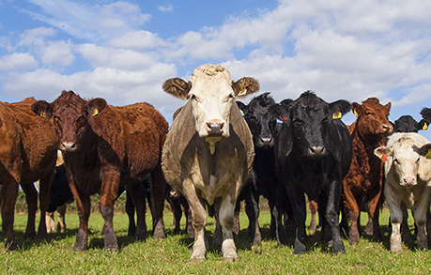
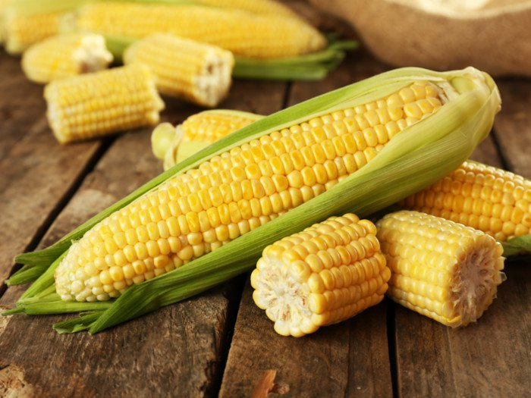
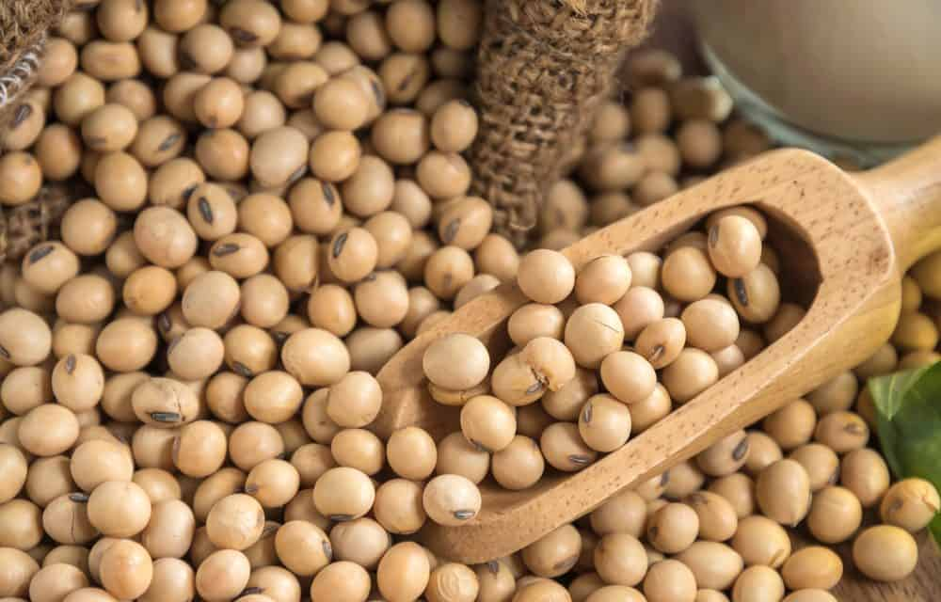
The Serial Dependence of the Commodity Futures Returns: A Machine Learning Approach
By Yufeng Han and Lingfei Kong
Presenter: Lingfei Kong

Slide 2
Research questions
Do lagged returns (for all commodity futures) contain predictability?
-Yes (Ann mean 15.15%, Sharpe 0.93; Robust to transaction cost)
What explains the predictability of the lagged returns?
-Financialization

Slide 3
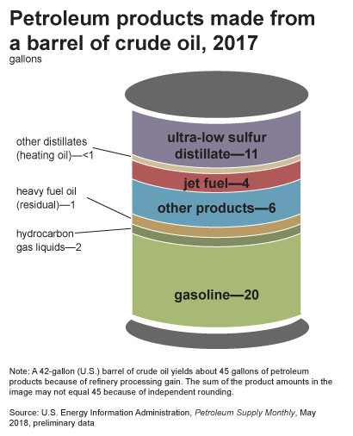
Motivation
Many commodities have economic links that can drive the lead-lag relation among futures returns.
Heating oil and gasoline are refined from crude oil, so it is possible that the lagged returns of crude oil futures can be tied to the returns of heating oil futures.
Crops such as corn and soybeans are used to produce biofuels, which are substitutes for fossil fuels such as crude oil

Slide 4
Motivation
Increasing speculative trading during the post financialization period (after 2004)
Da, Tang, and Wu (2020)
Gong, Gozluklu, and Kima (2020)
Excess contemporaneous co-movement during the post financialization period.
Basak and Pavlova, 2016
Tang and Xiong, 2012, Le Pen and Sevi, 2018
Notes:
can result in sentiment spillover across indexed commodities, causing price pressure and subsequent price reversals at daily level for indexed commodity futures. (Da, Tang, and Wu, 2020)
Spillover effects among grain and energy commodity due to biofuels generated from crops
Tang and Xiong (2012): contemporaneous comovement between the prices of non-energy commodity futures and oil futures after 2004
Le Pen and Sevi (2018): strong contemporaneous correlations between commodity futures returns across different sectors that have no economic links (e.g., positive relation between cattle and copper futures).

Slide 5
Motivation
The majority of CTAs (Commodity trading advisors) are trend-followers who chase time series momentum or other trend signals.
Momentum is probability caused partially by the lead-lag relations between the securities (Lewellen, 2002; DeMiguel, Nogales, and Uppal, 2014).
Notes:
A Commodity trading advisor (CTA) is US financial regulatory term for an individual or organization who is retained by a fund or individual client to provide advice and services related to trading in futures contracts, commodity options and/or swaps. They are responsible for the trading within managed futures accounts.
DeMiguel, Nogales, and Uppal (2014) they find that their model outperforms many existing benchmark models such as the naïve 1/N and the unconditional mean-variance model.

Slide 6
Motivation
A natural extension of the above literature.
We examine the lead-lag relations among a broad set of commodity futures returns and exploit predictability.

Slide 7
Contribution
This paper is the first to directly analyze the predictability of the lagged futures returns that allows each individual commodity future's return to respond to the lagged returns for all commodity futures, thereby accommodating a large dimension of commodity links, both direct and indirect.
Use machine learning technique to overcome the potential over-fitting problem and select predictors.
Much better performance (Ann mean 15.15%; Sharpe 0.93) than the two diversified commodity indices, SPGSCI index (mean -2.63%) and BCOM index (mean -2.4%) during 2009-2019

Slide 8
Methodology
Data generating process:
For every commodity futures n:
No. of predictors: 27*2=54
No. of obs used to fit the model: 192 in the full-sample, 60-month estimate window in the out-of-sample analysis
A large number of predictors can cause overfitting problem, i.e., increase the R-squared of the in-sample regression but generate bad out-of-sample fits.

Slide 9
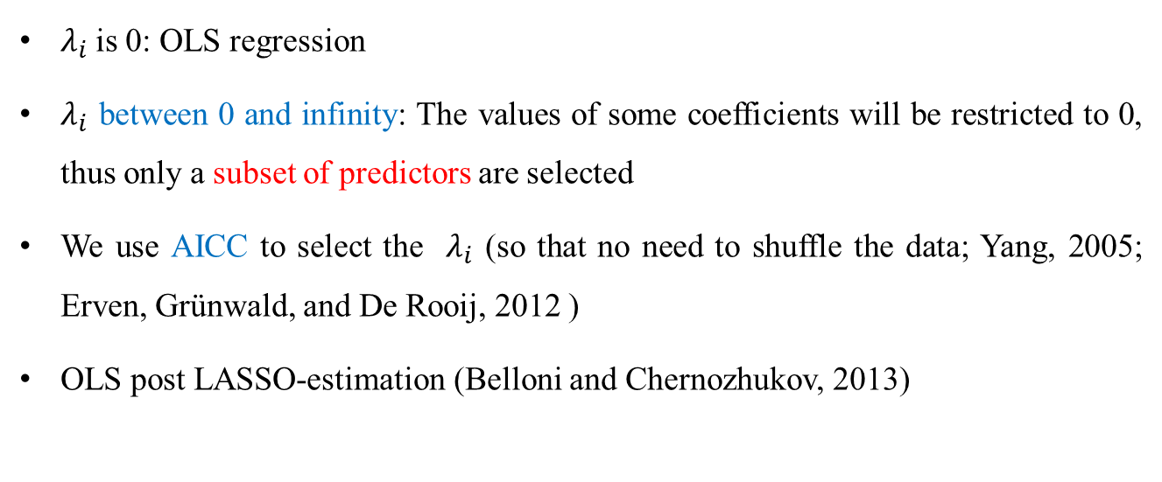
Methodology: LASSO
The LASSO (Least Absolute Shrinkage and Selection Operator):
Tibshirani (1996)
$λ_{i}$is 0: OLS regression
$λ_{i}$ between 0 and infinity: The values of some coefficients will be restricted to 0, thus only a subset of predictors are selected
We use AICC to select the $λ_{i}$ (so that no need to shuffle the data; Yang, 2005; Erven, Grünwald, and De Rooij, 2012 )
OLS post LASSO-estimation (Belloni and Chernozhukov, 2013)
Notes:
Residual some of squares
). However, BIC is not minimax optimal, i.e., it requires a lot of sample to get the true model selected, more than other criterion such as AIC, therefore it must have a worse mean average squared error than AIC (Yang, 2005; Erven, Grünwald, and De Rooij, 2012). The corrected Akaike information criterion (AICC) corrects for the small sample size. The AICC is defined as:

Slide 10
Methodology: Predictive regression
Full-sample estimation: OLS post-LASSO regression using the full sample period Jan 2004-Dec 2019
Out-of-sample estimation: 60-month rolling regressions to estimate the coefficients, then do one-step forecast
 |  | In-sample period |  |  |  |  |  | Out-of-sample period
Jan-04 |  |  |  | Dec-08 | Jan-09 | Feb-19 |  |  |  |  |  | Dec-18
Jan-04 |  |  |  | Dec-08
 | Feb-04 |  |  |  | Jan-09
 |  | 3/21/2004 |  |  |  | Feb-09

Slide 11
Data
We study 27 commodity futures that are traded actively in the US. The data are collected from Bloomberg.
Full sample period: Jan 2004 to December 2019.
The Out-of-sample period: Jan 2009 to December 2019.
8 grains futures, 7 softs futures, 3 livestock futures, 4 energy futures, and 5 metal futures
Where $F_{t+1}^{T_{n}}$ is the settlement price of the first-nearest futures contract held in month t that expires after month t+2.

Slide 12
Table 2 Full-sample results, Jan 2004-Dec 2019
 | (1) | (2) | (3) | (4) | (5) | (6) | (7) | (8)
Regressor | Regressand
 | Cocoa | Coffee | Copper | Corn | Cotton | Crude Oil | Gasoline | Heating Oil
Cocoa1 | -0.19*** | - | - | - | - | - | - | -
Coffee1 | -0.15** | - | - | - | - | - | - | -
Coffee2 | 0.19*** | - | - | 0.11 | - | - | - | -
Copper1 | -0.14 | - | 0.16** | - | - | - | - | -
Copper2 | - | - | - | - | - | 0.16 | 0.2** | 0.19*
Cotton1 | -0.05 | - | - | - | - | - | - | -
Cotton2 | - | - | - | 0.12 | 0.07 | - | - | -
Crude Oil1 | - | - | - | - | - | 0.17** | - | 0.11
Crude Oil2 | - | - | - | - | - | - | - | -
Feeder Cattle2 | - | - | - | - | - | - | -0.32*** | -
Gasoline2 | -0.05 | - | - | -0.14** | - | - | - | -
Gold2 | - | - | - | - | - | - | - | -
Heating Oil2 | - | - | - | - | - | - | - | -
Kansas Wheat2 | -0.06 | - | - | - | - | - | - | -
Lean Hogs1 | - | - | - | 0.19** | 0.14* | - | - | -
Lumber1 | 0.13** | - | - | - | 0.18*** | - | - | -
Lumber2 | -0.12** | - | - | - | - | - | - | -
Milk1 | - | 0.17 | - | 0.2*** | - | - | - | -
Milk2 | - | 0.27*** | - | - | - | - | 0.18** | -
Notes:
Autocorrelation; corn and gasoline; lean hogs and corn; unexpected relations;
Futures with intercept only: milk (N), oats(N), palladium(N), platinum(N), rough rice(N) ; feeder cattle (half) gold, silver (indexed), natural gas (indexed)

Slide 13
Full-sample results
The selected effects are sparse and sometimes unexpected.
The correlations between commodity futures prices go up with financialization (e.g., Basak and Pavlova, 2016).
Index traders add noise to commodity futures market (e.g., Tang and Xiong, 2012; Bosch and Pradkhan, 2016; Da, Tang, and Wu, 2020)
Chinco, Clark-Joseph, and Ye (2019):They identify a set of unanticipated lagged returns as predictors for the individual stock returns during a 30-minute interval based on LASSO.
Notes:
, because the traders are speculators who do not have physical exposure to the underlined commodities and who bet on the price movement

Slide 14
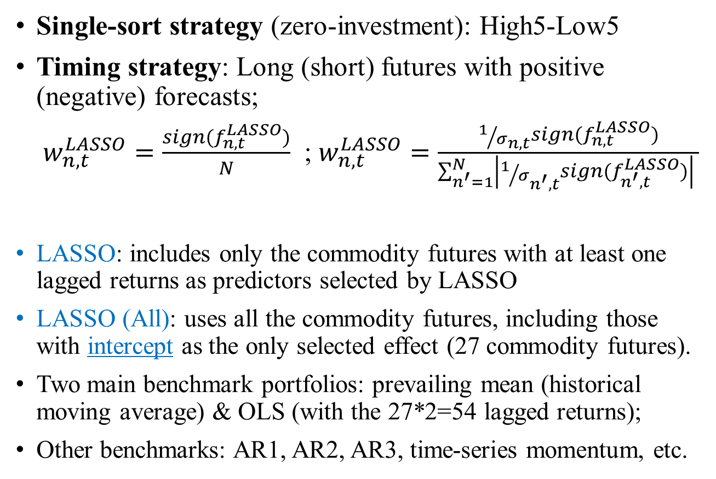
Out-of-sample test
Single-sort strategy (zero-investment): High5-Low5
Timing strategy: Long (short) futures with positive (negative) forecasts;
$w_{n,t}^{LASSO}=\frac{sign(f_{n,t}^{LASSO})}{N}$ ; $w_{n,t}^{LASSO}=\frac{1/{σ_{n,t}}sign(f_{n,t}^{LASSO})}{\sum_{n^{′}=1}^{N}{\left|1/{σ_{n^{′},t}}sign(f_{n^{′},t}^{LASSO})\right| }}$
LASSO: includes only the commodity futures with at least one lagged returns as predictors selected by LASSO
LASSO (All): uses all the commodity futures, including those with intercept as the only selected effect (27 commodity futures).
Two main benchmark portfolios: prevailing mean (historical moving average) & OLS (with the 27*2=54 lagged returns);
Other benchmarks: AR1, AR2, AR3, time-series momentum, etc.
Notes:
Moskowitz, Ooi, and Pedersen, 2012

Slide 15
Out-of-sample test
Table 3 Performance of the single-sort portfolios, Jan 2009-Dec 2019
Forecasts | Ann. mean (%) | Ann. std (%) | Ann. Sharpe Ratio | Ann. DR (%) | Ann. Sortino Ratio (%) | Tstat
LASSO | 15.15 | 16.24 | 0.93 | 8.28 | 1.83 | 3.09
LASSO (All) | 14.67 | 17.17 | 0.85 | 8.61 | 1.70 | 2.83
Prevailing.mean | 1.78 | 17.56 | 0.10 | 12.10 | 0.15 | 0.34
OLS | -4.22 | 20.40 | -0.21 | 14.91 | -0.28 | -0.69
AR1 | 11.20 | 18.02 | 0.62 | 10.24 | 1.09 | 2.06
AR2 | 11.14 | 18.75 | 0.59 | 10.96 | 1.02 | 1.97
AR3 | 9.91 | 16.81 | 0.59 | 9.70 | 1.02 | 1.96
Momentum | 5.93 | 15.14 | 0.39 | 9.84 | 0.60 | 1.30
Basis | 9.01 | 17.96 | 0.50 | 11.70 | 0.77 | 1.66
Hedging pressure | 1.61 | 16.64 | 0.10 | 11.39 | 0.14 | 0.32
Basis and momentum | 8.17 | 16.28 | 0.50 | 9.74 | 0.84 | 1.66
Basis, momentum, and hedging pressure | 6.91 | 14.89 | 0.46 | 9.51 | 0.73 | 1.54

Slide 16
Table 5a Performance of the timing portfolios, Jan 2009-Dec 2019
Forecasts | Ann. mean (%) | Ann. std (%) | Ann. Sharpe Ratio | Ann. DR (%) | Ann. Sortino Ratio (%) | Tstat | Ann.alpha (%) | Alpha.tstat
LASSO | 6.15 | 8.52 | 0.72 | 5.30 | 1.16 | 2.40 | 7.154*** | (3.092)
LASSO (All) | 3.53 | 6.64 | 0.53 | 4.31 | 0.82 | 1.76 | 4.133*** | (2.71)
Prevailing.mean | 1.80 | 7.32 | 0.25 | 5.29 | 0.34 | 0.82 | 1.461 | (1.141)
OLS | 0.12 | 7.18 | 0.02 | 5.04 | 0.02 | 0.06 | 1.029 | (0.506)
AR1 | 2.61 | 6.39 | 0.41 | 4.41 | 0.59 | 1.36 | 2.306 | (1.297)
AR2 | 2.86 | 6.50 | 0.44 | 3.95 | 0.72 | 1.46 | 2.167 | (1.259)
AR3 | 1.73 | 6.00 | 0.29 | 3.69 | 0.47 | 0.96 | 0.83 | (0.483)
Momentum | 0.01 | 6.48 | 0.00 | 4.69 | 0.00 | 0.00 | -0.134 | (-0.095)
Basis | 2.92 | 6.96 | 0.42 | 4.84 | 0.60 | 1.39 | 2.87** | (2.087)
Hedging pressure | -0.84 | 5.60 | -0.15 | 3.86 | -0.22 | -0.50 | -0.54 | (-0.378)
Basis and momentum | 1.13 | 6.54 | 0.17 | 4.73 | 0.24 | 0.57 | 0.881 | (0.484)
Basis, momentum, and hedging pressure | 0.36 | 5.50 | 0.06 | 3.90 | 0.09 | 0.21 | 0.224 | (0.119)
Tsmom | -0.39 | 8.93 | -0.04 | 6.67 | -0.06 | -0.15 | 1.081 | (0.619)
Notes:
Goyal and Jegadeesh (2017) : the total position is equal to $2 for the single-sort strategy

Slide 17
Table 4 Abnormal alphas for the single-sort portfolios, Jan 2009-Dec 2019
Variables | LASSO | LASSO (All) | Prevailing.mean | OLS | AR1 | AR2 | AR3 | Momentum | Basis | Hedging pressure | Basis and momentum | Basis, momentum, and hedging pressure
Intercept (%) | 1.338*** | 1.174** | -0.105 | -0.2 | 0.781* | 0.775* | 0.672 | 0.428 | 0.604 | 0.185 | 0.592 | 0.581
 | (2.784) | (2.289) | (-0.252) | (-0.417) | (1.75) | (1.827) | (1.456) | (1.319) | (1.489) | (0.512) | (1.656) | (1.534)
Average | 15.3 | 20.553 | 34.132*** | 5.535 | 10.397 | 13.679 | 9.433 | 16.539* | 32.705** | 14.26 | 32.079** | 11.507
 | (0.95) | (1.524) | (3.562) | (0.261) | (0.811) | (0.908) | (0.838) | (1.775) | (2.268) | (1.17) | (2.518) | (1.07)
Basis | -2.554 | -2.258 | -1.098 | -2.619 | 9.57 | 10.984 | 7.64 | 2.223 | -5.981 | 1.007 | 3.355 | -4.9
 | (-0.308) | (-0.204) | (-0.121) | (-0.232) | (0.689) | (0.878) | (0.704) | (0.288) | (-0.562) | (0.12) | (0.423) | (-0.725)
HP | -8.411 | 6.408 | 31.459*** | -10.899 | 15.586 | 12.565 | 14.558* | 8.257 | 21.308* | -1.495 | 6.582 | 1.014
 | (-0.79) | (0.607) | (4.126) | (-0.964) | (1.062) | (1.056) | (1.751) | (0.864) | (1.887) | (-0.13) | (0.572) | (0.1)
Momentum | 2.8 | 4.752 | 32.394*** | 19.628* | 10.482 | 0.14 | 1.169 | 11.128 | 15.472 | 26.592*** | -1.06 | 1.515
 | (0.309) | (0.595) | (3.414) | (1.755) | (0.871) | (0.016) | (0.143) | (1.012) | (1.335) | (2.902) | (-0.092) | (0.163)
Adj.rsquared | -1.177% | 0.157% | 38.202% | -0.150% | 5.988% | 1.827% | 2.290% | 3.431% | 11.739% | 6.569% | 4.191% | -1.802%

Slide 18
Table 5b Performance of the timing portfolios, 1/EWMA weighted, Jan 2009-Dec 2019
Forecasts | Ann. mean (%) | Ann. std (%) | Ann. Sharpe Ratio | Ann. DR (%) | Ann. Sortino Ratio (%) | Tstat | Ann.alpha (%) | Alpha.tstat
LASSO | 9.53 | 11.27 | 0.85 | 6.46 | 1.47 | 2.81 | 10.726*** | (2.829)
LASSO (All) | 7.88 | 9.56 | 0.82 | 5.62 | 1.40 | 2.73 | 8.597*** | (2.741)
Prevailing.mean | 2.73 | 8.35 | 0.33 | 5.72 | 0.48 | 1.08 | 1.696 | (0.954)
OLS | -1.06 | 9.68 | -0.11 | 6.94 | -0.15 | -0.36 | 0.629 | (0.23)
AR1 | 4.44 | 8.02 | 0.55 | 4.54 | 0.98 | 1.84 | 3.873 | (1.491)
AR2 | 4.12 | 8.13 | 0.51 | 4.72 | 0.87 | 1.68 | 3.571 | (1.544)
AR3 | 2.85 | 7.64 | 0.37 | 4.41 | 0.65 | 1.24 | 1.948 | (0.829)
Momentum | 2.09 | 8.32 | 0.25 | 5.42 | 0.39 | 0.83 | 1.627 | (0.727)
Basis | 1.50 | 9.19 | 0.16 | 6.87 | 0.22 | 0.54 | 1.42 | (0.649)
Hedging pressure | 0.01 | 7.58 | 0.00 | 5.27 | 0.00 | 0.00 | 0.331 | (0.191)
Basis and momentum | 1.85 | 8.94 | 0.21 | 6.19 | 0.30 | 0.69 | 1.493 | (0.578)
Basis, momentum, and hedging pressure | 1.59 | 7.95 | 0.20 | 5.55 | 0.29 | 0.66 | 1.929 | (0.725)
Tsmom | -1.86 | 11.06 | -0.17 | 8.57 | -0.22 | -0.56 | -0.218 | (-0.099)
Notes:
Goyal and Jegadeesh (2017) : the total position is equal to $2 for the single-sort strategy

Slide 19
Tests of Financialization
Table 7 Out-of-sample portfolio performance using indexed futures only
Forecasts | Ann. mean (%) | Ann. std (%) | Ann. Sharpe Ratio | Ann. DR (%) | Ann. Sortino Ratio (%) | Tstat | Ann.alpha (%) | Alpha.tstat
Panel A: Single-sort portfolio
Prevailing mean | 4.14 | 17.54 | 0.24 | 11.88 | 0.35 | 0.78 | -0.33 | (-0.07)
OLS | 10.90 | 20.33 | 0.54 | 11.59 | 0.94 | 1.78 | 10.75 | (1.57)
LASSO | 13.00 | 18.69 | 0.70 | 10.54 | 1.23 | 2.31 | 13.26** | (2.33)
LASSO (All) | 11.48 | 17.87 | 0.64 | 10.26 | 1.12 | 2.13 | 10.04 | (1.64)
Panel B: Timing portfolio
Prevailing mean | 2.12 | 9.55 | 0.22 | 6.76 | 0.31 | 0.74 | 1.38 | (0.56)
OLS | 1.26 | 10.04 | 0.13 | 6.83 | 0.18 | 0.41 | 2.71 | (0.91)
LASSO | 8.62 | 12.43 | 0.69 | 7.46 | 1.16 | 2.30 | 9.90** | (2.34)
LASSO (All) | 6.93 | 9.40 | 0.74 | 4.90 | 1.41 | 2.44 | 7.68** | (2.45)

Slide 20
Tests of Financialization
Table 7 Out-of-sample portfolio performance using indexed futures only
Forecasts | Ann. mean (%) | Ann. std (%) | Ann. Sharpe Ratio | Ann. DR (%) | Ann. Sortino Ratio (%) | Tstat | Ann.alpha (%) | Alpha.tstat
Panel A: Single-sort portfolio
Prevailing mean | 4.14 | 17.54 | 0.24 | 11.88 | 0.35 | 0.78 | -0.33 | (-0.07)
OLS | 10.90 | 20.33 | 0.54 | 11.59 | 0.94 | 1.78 | 10.75 | (1.57)
LASSO | 13.00 | 18.69 | 0.70 | 10.54 | 1.23 | 2.31 | 13.26** | (2.33)
LASSO (All) | 11.48 | 17.87 | 0.64 | 10.26 | 1.12 | 2.13 | 10.04 | (1.64)
Panel B: Timing portfolio
Prevailing mean | 2.12 | 9.55 | 0.22 | 6.76 | 0.31 | 0.74 | 1.38 | (0.56)
OLS | 1.26 | 10.04 | 0.13 | 6.83 | 0.18 | 0.41 | 2.71 | (0.91)
LASSO | 8.62 | 12.43 | 0.69 | 7.46 | 1.16 | 2.30 | 9.90** | (2.34)
LASSO (All) | 6.93 | 9.40 | 0.74 | 4.90 | 1.41 | 2.44 | 7.68** | (2.45)

Slide 21
Tests of Financialization
Table 8 Out-of-sample portfolio performance using non-indexed futures only
Forecasts | Ann. mean (%) | Ann. std (%) | Ann. Sharpe Ratio | Ann. DR (%) | Ann. Sortino Ratio (%) | Tstat | Ann.alpha (%) | Alpha.tstat
Panel A: Single-sort portfolio
Prevailing mean | 1.70 | 17.38 | 0.10 | 11.42 | 0.15 | 0.32 | 1.42 | (0.29)
OLS | -0.97 | 19.94 | -0.05 | 14.62 | -0.07 | -0.16 | -1.38 | (-0.21)
LASSO | 4.02 | 30.06 | 0.13 | 19.85 | 0.20 | 0.44 | 2.18 | (0.29)
LASSO (All) | 0.37 | 18.35 | 0.02 | 13.10 | 0.03 | 0.07 | -1.27 | (-0.27)
Panel B: Timing portfolio
Prevailing mean | 1.60 | 9.79 | 0.16 | 6.62 | 0.24 | 0.54 | 2.32 | (1.00)
OLS | 3.40 | 11.01 | 0.31 | 7.49 | 0.45 | 1.02 | 3.75 | (1.02)
LASSO | -0.91 | 16.15 | -0.06 | 11.14 | -0.08 | -0.19 | -0.08 | (-0.02)
LASSO (All) | 1.03 | 10.15 | 0.10 | 6.90 | 0.15 | 0.34 | 1.541 | (0.50)

Slide 22
Tests of Financialization
Table 9 LASSO predictive regression with interactions of ETF inception dummy
 | (1) | (2) | (3) | (4) | (5) |  | (6) | (7)
 | Regressand
Regressor | Coffee | Copper | Corn | Cotton | Crude Oil |  | Gasoline | Heating Oil
(Intercept) | 0 | 0.04*** | 0 | 0 | 0 |  | 0 | 0
d_ETF | - | -0.04*** | - | - | - |  | - | -
Cocoa1 | - | - | - | - | - |  | - | -
Cocoa2 | - | - | - | - | - |  | - | -
Cocoa2*d_ETF | - | - | - | - | - |  | - | -
Coffee1 | - | - | - | - | - |  | - | -
Coffee1*d_ETF | - | - | - | 0.07 | - |  | - | -
Coffee2 | - | - | - | - | - |  | - | -
Coffee2*d_ETF | - | - | 0.1 | - | - |  | - | -
Copper1 | - | 0.05 | - | - | - |  | - | -
Copper2 | - | - | - | - | 0.15 |  | 0.22** | 0.18*
Corn2*d_ETF | - | - | - | - | 0.15** |  | - | 0.13
----------------------------------------------------------------------------------------------------------------------
Total number of interactions | 0 | 3 | 6 | 5 | 2 | 0 | 0 | 2
Fstat | - | 4.912*** | 4.606*** | 3.827*** | 5.346*** | - | - | 2.562*
 | 5.30% | 13.66% | 15.76% | 12.34% | 11.51% | 14.35% | 14.35% | 11.62%
At least one lagged commodity futures return is selected for 14 of the 16 indexed futures.
10 out of the 14 futures have interactions of ETF inception dummy (b/a Sept 2006) with lagged returns as selected effects.
Notes:
September 2006 as the threshold because of illiquid trading during the first several months.

Slide 23
Robustness Check
Transaction cost and turnover (rebalance and rollover)
Marshall, Nhnut, and Visaltanachoti (2012): half spreads between 3.1 to 4.4 basis points;
Turnover: 0-4 (single-sort); 0-2 (timing)
Estimation of annual transaction cost assuming monthly roll-over
12*4*4.4*0.01%=2.112% (single sort); 12*2*4.4*0.01%=1.056% (timing)
Out of sample portfolio adjusted for transaction cost
 | Before transaction cost |  |  | After transaction cost
Forecasts | Ann. mean (%) | Ann. std (%) | Ann. Sharpe Ratio | Ann. mean (%) | Ann. std (%) | Ann. Sharpe Ratio
Single-sort portfolio
LASSO | 15.15 | 16.24 | 0.93 | 13.038 | 16.24 | 0.80
LASSO (All) | 14.67 | 17.17 | 0.85 | 12.558 | 17.17 | 0.73
Timing portfolio
LASSO | 6.15 | 8.52 | 0.72 | 5.094 | 8.52 | 0.60
LASSO (All) | 3.53 | 6.64 | 0.53 | 2.474 | 6.64 | 0.37
Notes:
Han, he ,rapach, and zhou (2019) C-LASSO

Slide 24
Robustness Check
Different LASSO models
Adaptive LASSO, elastic net, and combination LASSO; use cross-validation to select penalty parameter (Chinco, Clark-Joseph, and Ye, 2019)
Add more lags (3 lags, now the number of variables are 81>60)
Adjusting for seasonality (add 11 month dummies)
Notes:
Han, he ,rapach, and zhou (2019) C-LASSO

Slide 25
Robustness Check: Trees and Neural networks
Tree-based models: account for nonlinearity and interactions between variables
Random forest: Breiman (2001)
Gradient boosting: Friedman (2001)
Neural networks: ‘among the least transparent, least interpretable, and most highly parameterized machine learning tools’
Gu, Kelly, and Xiu (2020): “In small data sets, simple networks with only a few layers and nodes often perform best”.
Filippou, Rapach, Taylor, and Zhou (2020): neural networks perform worse than Elastic net in predicting exchange rate

Slide 26
Robustness Check
Table 11 Tree-based models (500 trees)
Forecasts | Ann. mean (%) | Ann. std (%) | Ann. Sharpe Ratio | Ann. DR (%) | Ann. Sortino Ratio (%) | Tstat | Ann.alpha | Alpha.tstat
Panel A: Single-sort portfolio
Gradient boosting | 12.54 | 17.56 | 0.71 | 10.77 | 1.16 | 2.37 | 11.41* | (1.96)
Random forest | 13.58 | 17.19 | 0.79 | 10.08 | 1.35 | 2.62 | 11.15** | (2.43)
Panel B: Timing portfolio
Gradient boosting | 3.21 | 7.99 | 0.40 | 5.59 | 0.57 | 1.33 | 3.79 | (1.64)
Random forest | 2.67 | 7.90 | 0.34 | 5.34 | 0.50 | 1.12 | 2.08 | (0.88)

Slide 27
Robustness Check
Table 12 Neural networks with one hidden layer
Forecasts | Ann. mean (%) | Ann. std (%) | Ann. Sharpe Ratio | Ann. DR (%) | Ann. Sortino Ratio (%) | Tstat | Ann.alpha | Alpha.tstat
Panel A: Single-sort portfolio
8 neurons | 12.54 | 17.56 | 0.71 | 10.77 | 1.16 | 2.37 | 11.41* | (1.96)
16 neurons | 12.57 | 18.21 | 0.69 | 10.07 | 1.25 | 2.29 | 12.10** | (2.09)
32 neurons | 4.57 | 18.60 | 0.25 | 12.88 | 0.35 | 0.81 | 3.26 | (0.54)
Panel B: Timing portfolio
8 neurons | 3.21 | 7.99 | 0.40 | 5.59 | 0.57 | 1.33 | 3.79 | (1.64)
16 neurons | 3.69 | 8.81 | 0.42 | 6.07 | 0.61 | 1.39 | 4.68 | (1.61)
32 neurons | -5.20 | 10.45 | -0.50 | 8.63 | -0.60 | -1.65 | -5.71* | (-1.98)
Notes:
Gu et al (2019) find that tree-based models and neural network perform well in predicting stock markets. They use expanding window with minimum estimation window of 19 years, and the models are performed in a cross-sectional setting, thus the sample size is much larger than the number of anomalies. However, our LASSO regressions are time-series regressions and we do one-month ahead forecast.

Slide 28
Robustness Check
Filippou, Rapach, Taylor, and Zhou (2020): neural networks perform worse than Elastic net in predicting exchange rate.

Slide 29
Conclusion
The lagged commodity futures returns contain valuable information and can help forecast the returns of the commodity futures.
LASSO helps identify useful and “important predictors”.
LASSO portfolio can generate significant out-of-sample returns.
Tree based models and neural networks perform worse than LASSO.
Financialization causes the excess comovement among commodity futures returns.

Slide 30
Thank you!

