Slide 1
Comments on Bobenreith et al “A weak trend hides strong predictability”

Slide 2
Overview
Very good paper that addresses relatively conclusively an issue that has bedeviled commodity researchers for 30 years—the empirical failure of the standard storage model in low frequency data
Strong theoretical underpinnings
Excellent intuitive explanations
A few questions regarding estimation details

Slide 3
The Problem
Deaton-Laroque’s (1992) empirical puzzle: real world real prices are too highly autocorrelated to be explained by the standard storage model
Model prediction: high price years (stockout years) should be followed by substantial price declines in prices
Low frequency data: high price years followed by high price years with no tendency for prices to decline

Slide 4
Underlying Model
The prediction is based on a simple version of the storage model with a random harvest drawn from a distribution with a constant mean (no trend)
In this model, there is a cutoff price p* such that there is a stockout for higher prices and carryout for lower prices
Crucially, this cutoff price is constant over time—including the decades covered by the DL sample

Slide 5
The Current Paper
This paper shows that a simple and realistic change addresses the problem
In reality, there has been an upward trend in productivity, i.e., harvest shocks are not drawn from the same distribution: the mean is increasing over time
The paper shows that even a small annual productivity trend can have a big impact in a sample spanning decades

Slide 6
Intuition
Optimal storage is about scarcity today vs. expected scarcity next year
Given constant demand, the level of relative scarcity that makes a stockout optimal occurs at a higher price in early, low productivity years than in later years with higher productivity (due to the trend)
That is the stockout threshold p* is not constant over time: instead it increases

Slide 7
Mixing Apples & Oranges
DL model therefore misspecified
In early years with high price, carryout may still be optimal, so no big price decline after a high price but price grows at interest rate
In late years with a similarly high price, highly likely that there is a stockout, followed by a price decline
Conditioning on price therefore not very informative about future price movements, especially in long samples

Slide 8
The Approach In This Paper
This paper creates a detrended stockout price threshold which results in a different Euler equation:

Slide 9
Details, Details
Given the non-linearity, estimation using OLS involves addressing a lot of technical details
See the paper, and Bobenreith et al (2021) for these details

Slide 10
Results
Adjusting the detrended cutoff price by an exponentially growing trend makes early and late years comparable
The implications of the storage model broadly hold
Price grows at interest rate in years where price is below the cutoff, prices tend to jump downwards after years where price is above the cutoff

Slide 11
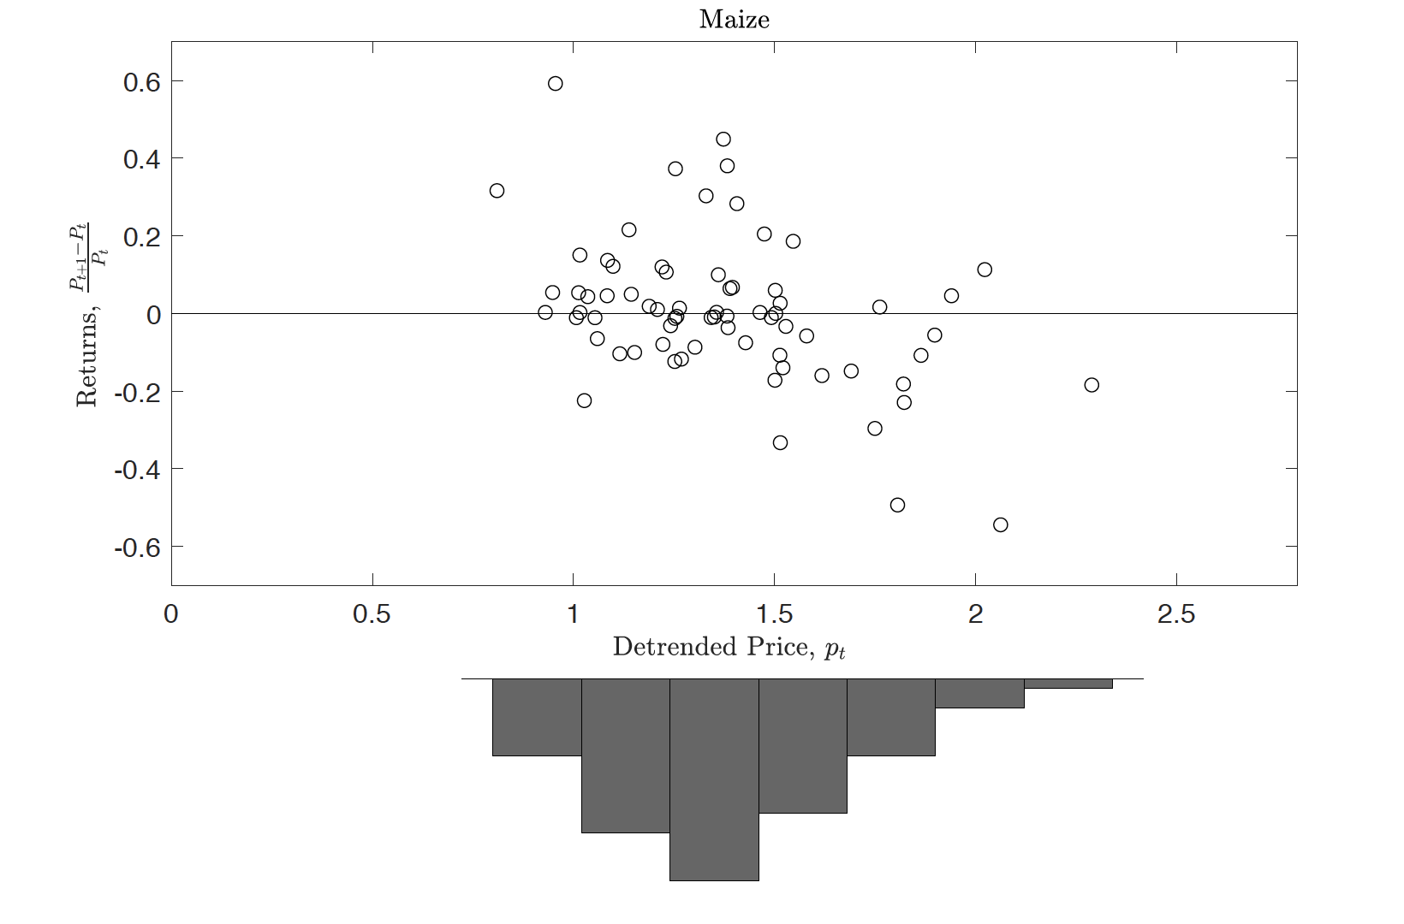
Results for Corn

Slide 12
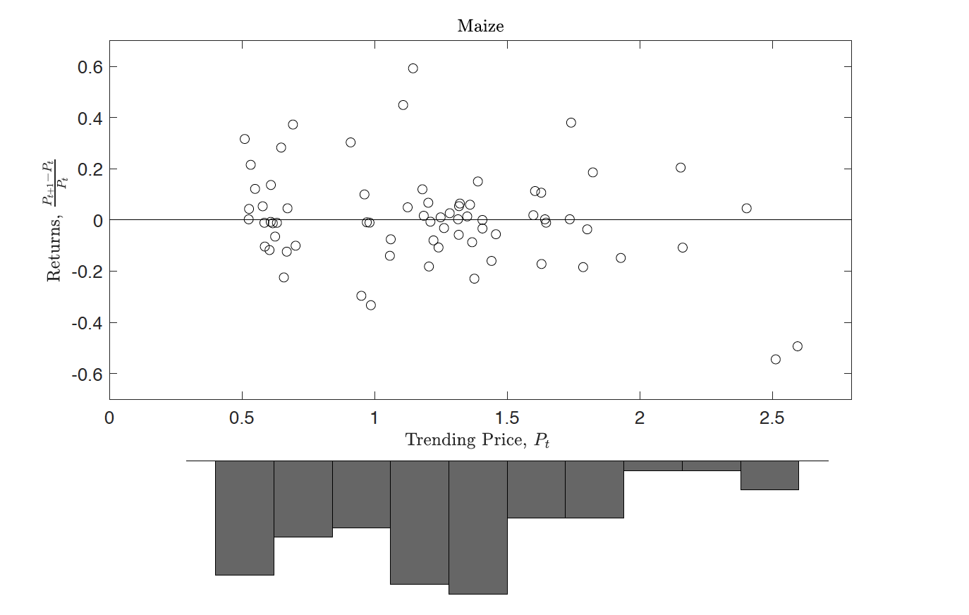
Without Detrending

Slide 13
Comments
No criticisms, but some questions regarding the error term
Distribution of errors goes virtually undiscussed
Is this because it doesn’t matter?
Seems that taking into account characteristics of errors could improve efficiency
Also, what about significance tests in small samples (paper relies on asymptotic results)?

Slide 14
Comments
No criticisms, but some questions regarding the error term
Distribution of errors goes virtually undiscussed
Is this because it doesn’t matter?
Seems that taking into account characteristics of errors could improve efficiency
Also, what about significance tests in small samples (paper relies on asymptotic results)?

Slide 15
WLS?
Original model:

Slide 16
Scaling
To permit identification, divide through both sides by P_{t}:

Slide 17
Heteroskedasticity
Dividing through by P_{t} means that even if the error terms in the unscaled model are homoscedastic (which they probably aren’t as prices should be more volatile in stockout environments) they aren’t in the scaled model that is estimated
Use WLS or GMM with weighting by the inverse of price to improve efficiency

Slide 18
Small Sample Properties
Relying on asymptotics is problematic given the relatively small sample sizes
Simulations and bootstraps would be useful for performing statistical tests that reflect the sample sizes in annual commodity price data sets

Slide 19
Final Thoughts
Excellent paper that shows that a simple, intuitive, and realistic enhancement can restore our faith in the standard storage model
Definitely worth the read!

